Slide 1
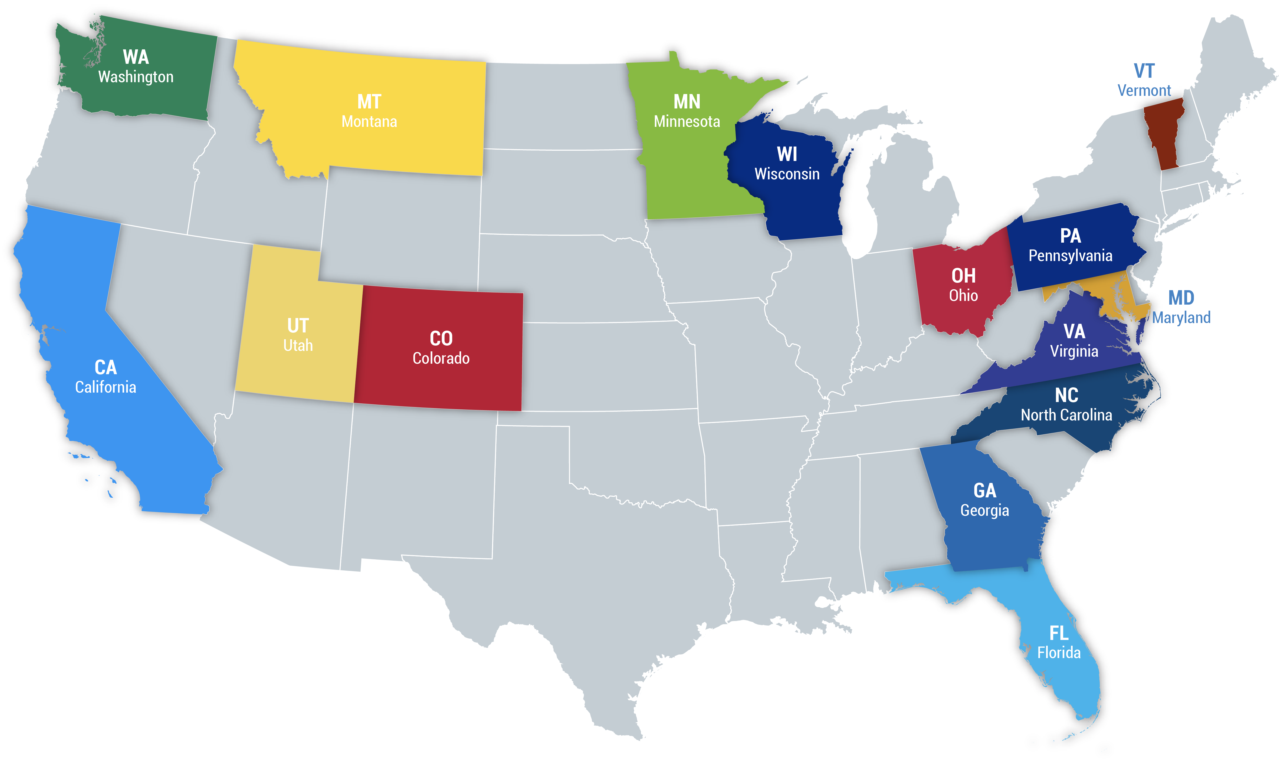
Launching a State Clinician Climate Action Website

Slide 2
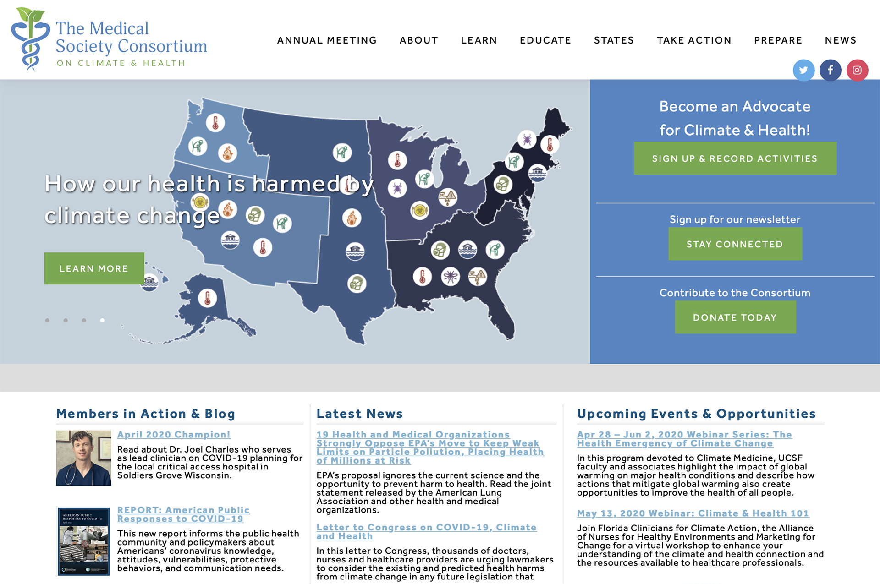
medsocietiesforclimatehealth.org
Notes:
The Consortium website is about organizing, empowering, and amplifying your voices. There are many resources useful to State groups. Visit medsocietiesforclimatehealth.org. There is a dedicated States section, which you can get to by clicking on STATES in the main menu.

Slide 3
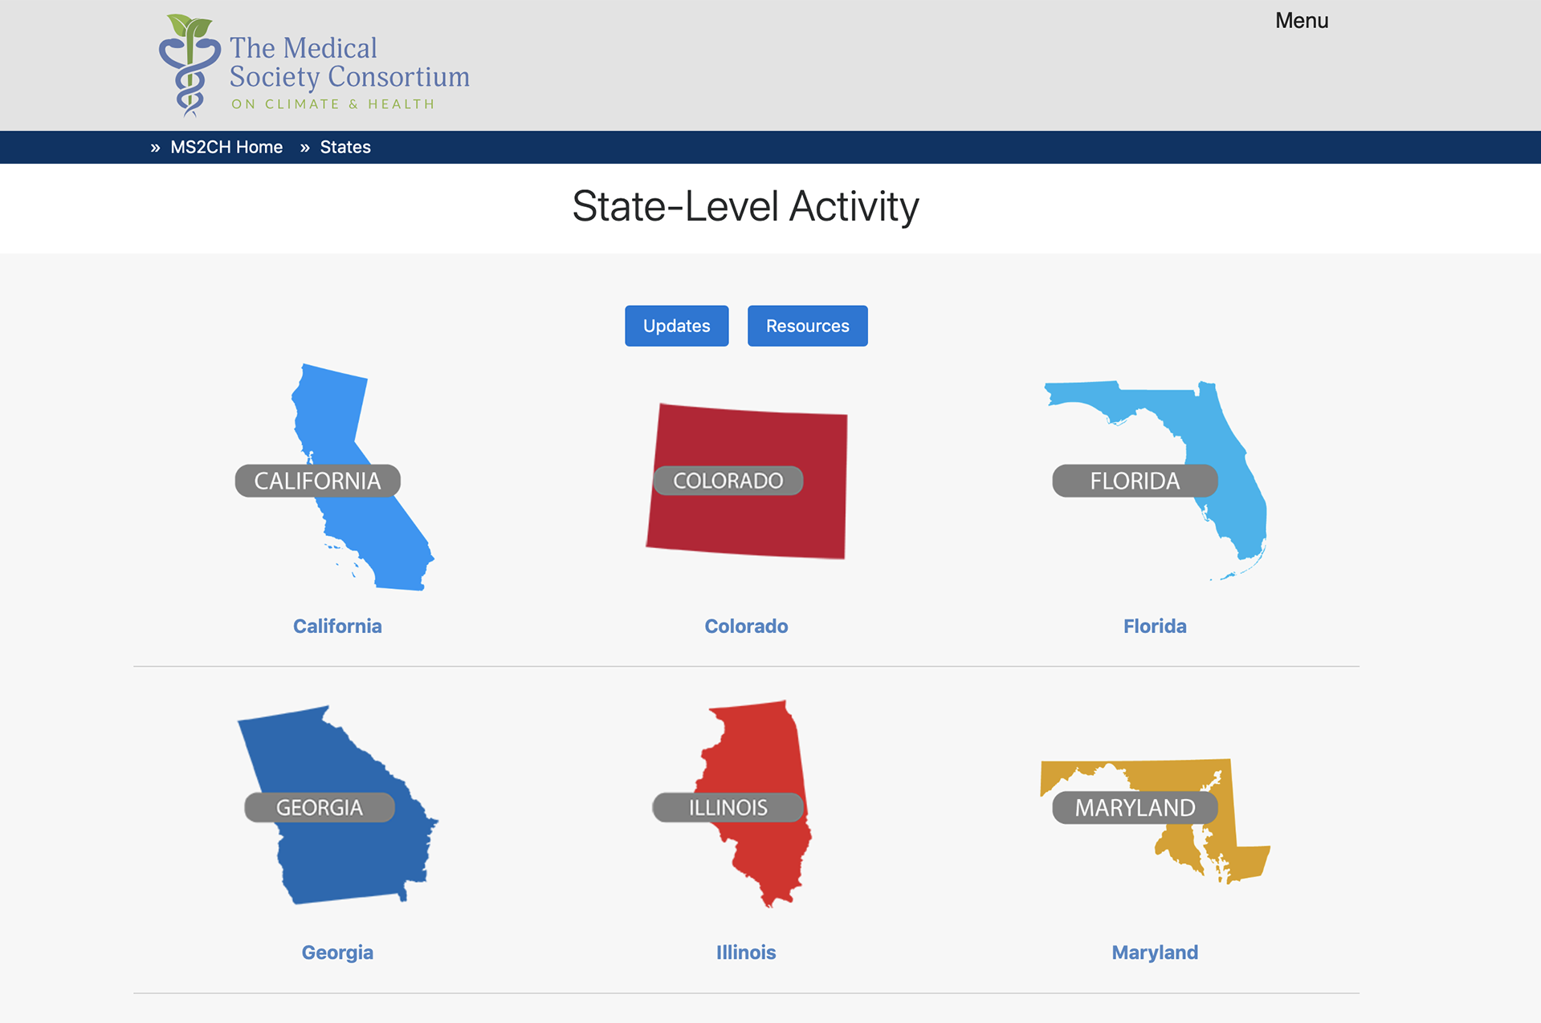
states.ms2ch.org
Notes:
By clicking on a state icon you’ll be able to see current Clinician Climate Action Groups and other organizations within that state who are focusing on climate and health. Having a dedicated STATES section on our website means:
You can have an online presence quickly and for free!
You can share information about what is happening in your State in the area of climate and health and recruit new members.
Other health professionals are able to see what groups are doing in their State, and become involved, or even be inspired to start a Clinician Climate Action group themselves!

Slide 4
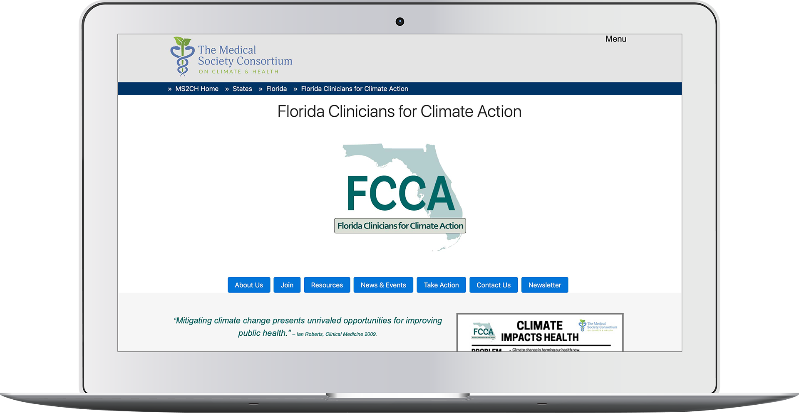
Website Option 1: Pages on the Consortium site
states.ms2ch.org/fl/fcca/
Notes:
There are a couple of options for a Clinician Climate Action Group to build a website:
Option1: The Consortium sets up the pages you’d like for your website. An example shown here is FCCA. This is hosted within the States section on the Consortium site. It’s a good option for newly formed groups who only require a fairly simple site and don’t have spare cash! You won’t be able to have your own domain name.

Slide 5
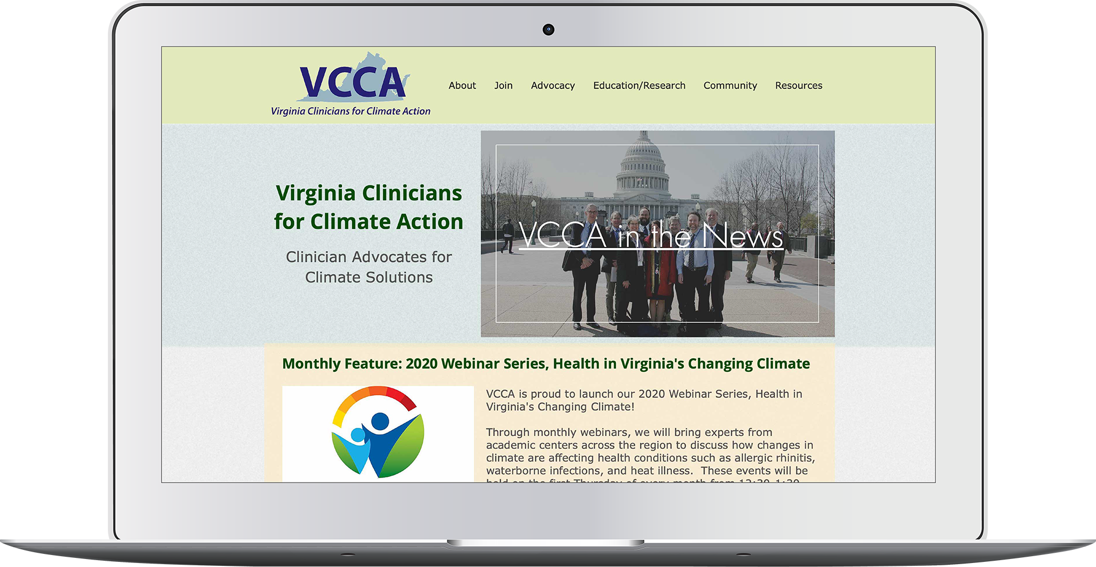
Website Option 2: Build your own!
virginiaclinicians.org
Notes:
Option 2: Build you own! Virginia Clinicians for Climate Action is a great example of how you can build your own site. VCCA quickly outgrew our capacity to maintain their website. They wanted to add dropdowns to their menu, and needed to upload documents, photos and resources for their members. VCCA were able to use the enthusiasm of several members to build this site using Wix. VCCA has their own domain name for their web address.

Slide 6
Build your own website (yes you can!)
Software programs:
Sites.Google.com Free, basic design options, domain name restrictions
Wix.com From $13/month, simple design options
Squarespace.com From $18/month, more complex design templates
Wordpress.com Free software, hosting costs, lots of templates and plugins, time consuming to learn, best for complex sites
PROS: Flexibility and freedom to make changes
CONS: Increased cost, time and expertise to build and maintain
Notes:
For building your own site, here are a few of the most popular programs:
Google Sites is free and you just need a google account to create a site. The site can only be quite basic and will be on google’s domain (meaning you can’t have your own domain name) eg. sites.google.com/view/yoursite
Services like Wix and Squarespace allow you to create a simple but effective website using drag and drop templates. Wordpress is a popular content management system (CMS) with lots of templates and plugins available to create quite complex sites. Learning Wordpress can be quite daunting and requires some initial website knowledge.
The benefit of maintaining your own site is that it gives you much more flexibility and freedom to make changes. The downside is the added cost and time to initially build the site, plus the ongoing costs for maintenance and hosting.

Slide 7
State Clinician Climate Action Logos
Template logo
Custom designed logo
Notes:
Logo. You’ll need a logo to brand your State Clinician Climate Action group and there are 2 options for this:
Have the Consortium create your logo based on our CCA logo template you see here. You can choose the wording and colors. This is the easiest options and it’s free! You can see Wisconsin and Georgia groups as examples.
Have it custom designed by a graphic designer. This option is much more expensive, but if your group would like something specific and unique this could be the option for you. A great example is Montana Health Professionals for a Healthy Climate.

Slide 8
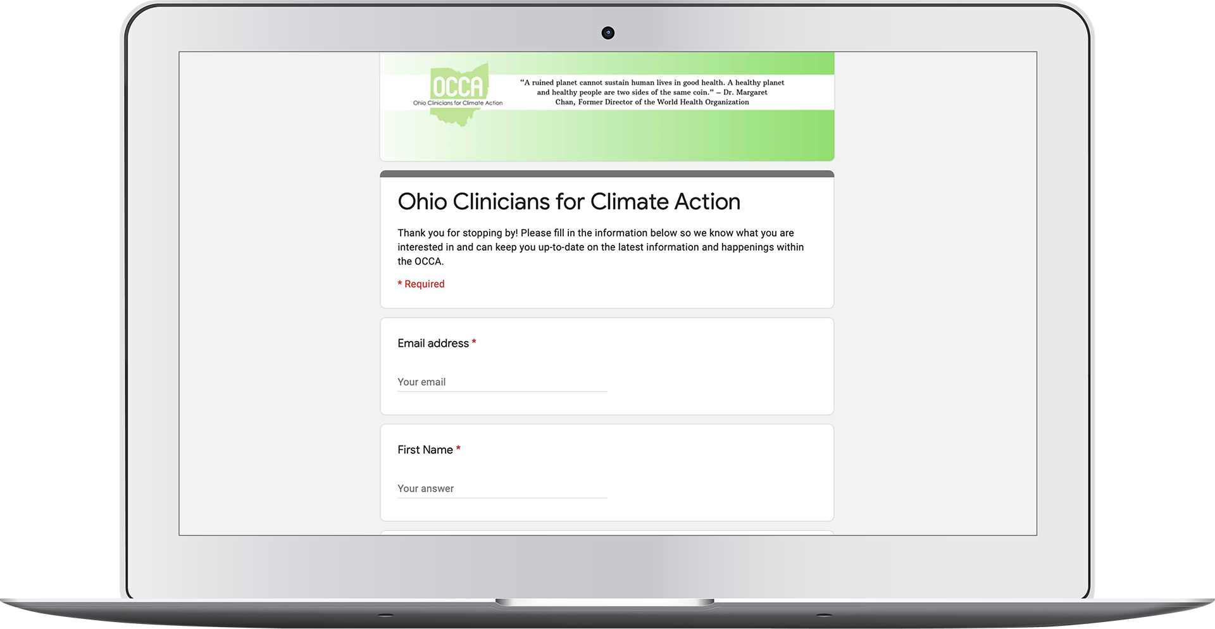
Creating and Maintaining a Mailing List
OPTION 1:
Google Form
Link from a sign-up button on your site to a Google Form
Control who can access your data
Export data into an Email Service Provider or Excel
JOIN US
SUBSCRIBE
OCCA collects subscribers using Google Form
Notes:
Mailing Lists. You’ll probably want to collect contact details of those interested in joining your group, or perhaps you’d like to start a newsletter.
These are 2 options for creating and maintaining a Mailing List:
OPTION 1: Create a signup page with Google Form. Use a “Join” or “Subscribe” button to link to your form. Google has some really good tutorials for beginners. You can maintain your data in a linked Google sheet. You’ll be able to export data out of this Google sheet and into an Email Service Provider as needed (like MailChimp), or into Excel. You’ll see an example on the screen – Ohio CCA uses Google Form to collect sign-ups for their mailing list.

Slide 9
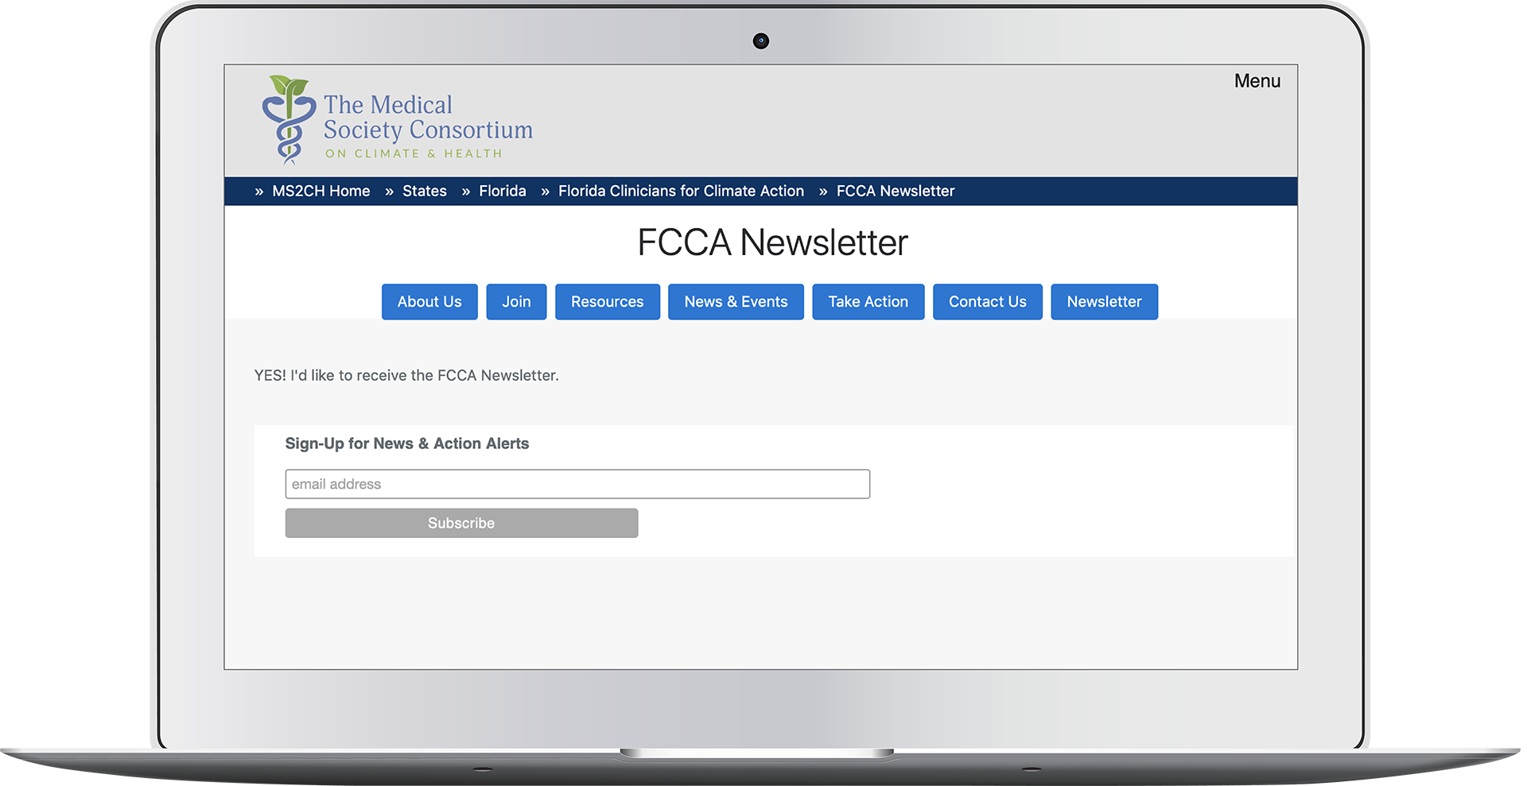
Creating and Maintaining a Mailing List
OPTION 2:
Email Service Providers
MailChimp
Emma
Constant Contact
FCCA uses an embedded MailChimp signup form to collect newsletter subscribers
Notes:
OPTION 2: MailChimp, Emma, and Constant Contact are some you may have heard of before. You can create signup forms, build and maintain your mailing list, and send newsletters and other communications. These services are initially free, but require a subscription once you exceed basic services. The Consortium uses MailChimp to send out newsletters to subscribers. Most Email Service Providers, including MailChimp, provide a form-building tool so you can create a “signup form”, that can then be added to your website. You can see an example of a MailChimp form embedded on the Florida CCA Newsletter signup page.

Slide 10
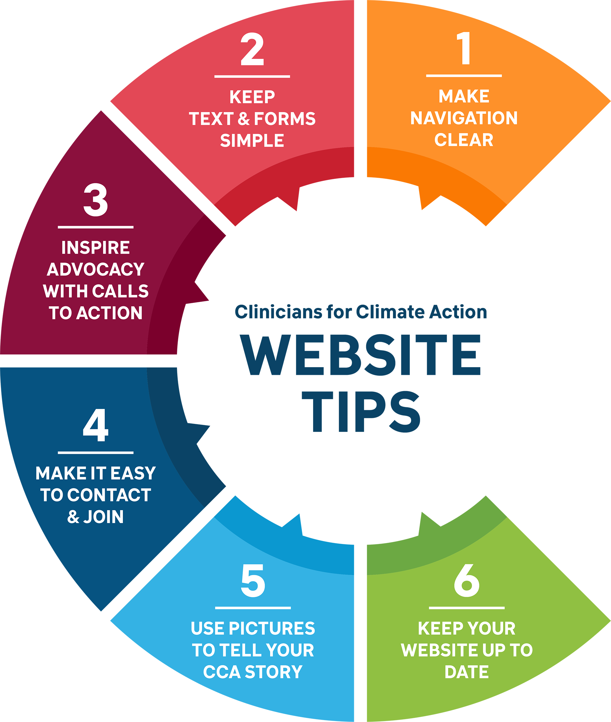
Website Tips
Keep it simple and clear – navigation, text and forms!
Inspire members with Calls to Action
Make your contact details and sign-up form easy to find
Use pictures to tell your story
Keep your website up to date
info@climateconsortium.org
Notes:
A few tips to keep in mind when creating a State Clinician Climate Action website…
Keep your website simple and clear. A cluttered navigation or too much content can frustrate users and they won’t stay on your site.
Inspire members to get involved by including calls to action!
Make your contact details easy to find and your forms quick and easy to fill out.
Use picture to tell your group’s story.
Keep your site up to date. If you’re short on time, keep information brief and broad so it has a longer shelf life.

