Slide 1
Todd L Sack, MD, FACP Editor, My Green Doctor Jacksonville, Florida tsack8@gmail.com 904-403-6446
Teaching Climate Change in Healthcare Offices
~ I have no financial disclosures ~
Notes:
Weather and climate change play a significant role in our health and well-being. I’m going to discuss some health issues related to waterborne infectious disease.
There are an estimated 12-19 million outbreaks of endemic waterborne disease annually in the US., with many of the infectious agents not identified….so probably a much bigger problem.

Slide 2
Teaching Climate Change in Healthcare Offices
My Green Doctor: What’s new
Survey results: What do health professionals want?

Slide 3
Our Partners & Participant Organizations
World Medical Association

Slide 4
What is “My Green Doctor”?
Launched on Earth Day, 2008
Free online practice management program
Brings environmental sustainability &
climate change preparedness to healthcare offices
Written by healthcare professionals
Suitable for any outpatient clinic
Science-based, non-political; no ads or banners
Tailored for use by all office staff members
No science background needed
>450 registered offices in 34 US states & 52 countries
Proven to save offices money

Slide 5
How It Works
Health professionals & office managers register at www.MyGreenDoctor.org
Learn how to add FIVE MINUTES of Green Team business to each
regular office staff meeting
Each meeting is scripted: nothing to study or prepare
Topics: Energy & water use, chemicals, purchasing, recycling,
pharmaceuticals disposal, transportation, healthy foods, renewable energy,
community advocacy & climate change preparedness
Offices save money in the first month
Can qualify for the Green Doctor Office Certificate

Slide 6
Our “Meeting-by-Meeting” Guide
Explains exactly what to say & do at each meeting
Nothing for the Team Leader to study or prepare
Focuses on slow, steady improvements
Patient & staff education emphasized
Encourages discussion & staff involvement
Provides “Green Team Notes” for easy record keeping

Slide 7
Patient Education
Education is a key part of the Green Doctor Office Certificate
13 waiting room brochures
4 brochures on climate change topics
5 waiting room posters
Our “Tip-of-the-Month” program
Blog essays on many topics
Videos & PowerPoints
Environmental sustainability policy for management
In simple language, evidence-based
100% backed by policies of health professional societies

Slide 8
Example: Escambia County Health Dept.
Saving energy every month
5.2% energy electricity saving per year
125,000 kilowatt hours electricity per year
85,600 metric tons CO₂ per year
Equivalent of 9,500 gallons gasoline
Bottom Line: $14,000 saved annually

Slide 9
Plans for 2019
Launching Spanish website & educational materials
Expanding on Facebook, Twitter & Instagram
Adding waiting room brochures
Increasing our focus on climate-vulnerable populations
Seeking a grant to print brochures & posters for offices
Seeking Partner organizations who wish to offer My Green
Doctor to their members (partnering is free)

Slide 10
2019 Survey of My Green Doctor Offices
“Thanks” to Professor Ed Maibach & PSR-Florida
Survey Monkey survey of 330 registered offices
Half were registered prior to 2018
18 questions in the survey
4-minute response time, anonymous
Goals of the survey were to assess:
Climate change knowledge
Knowledge about My Green Doctor
Needs for educational tools

Slide 11
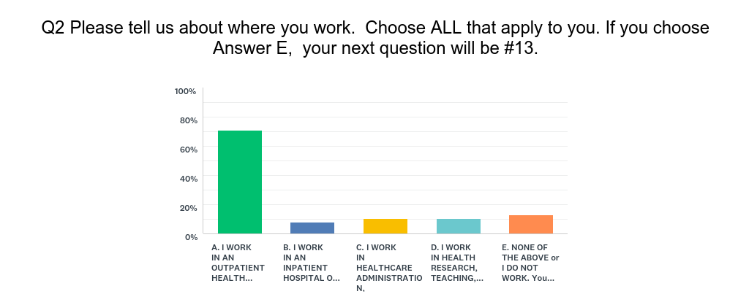

Slide 12
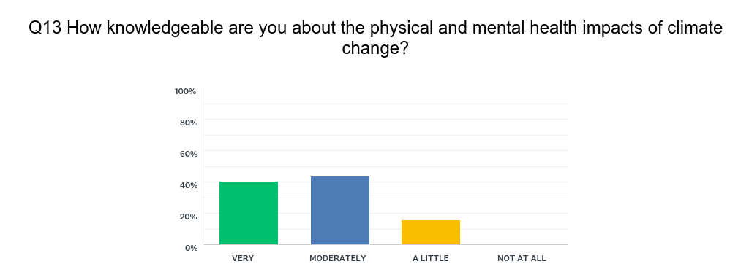

Slide 13
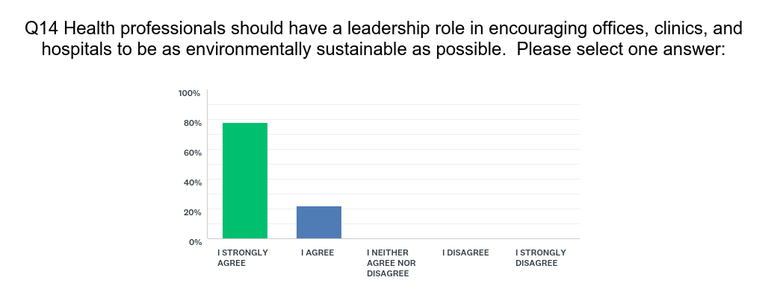

Slide 14
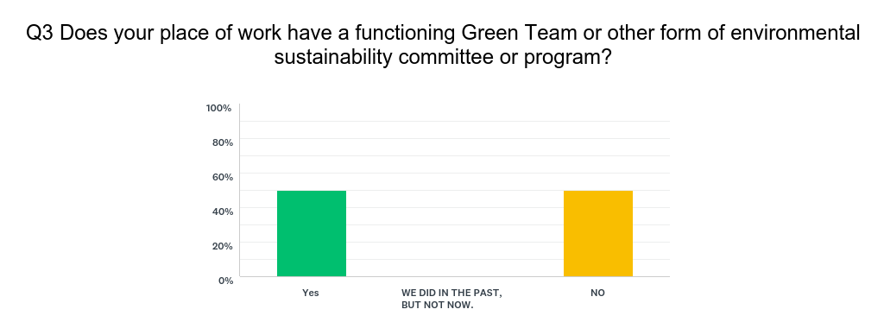

Slide 15
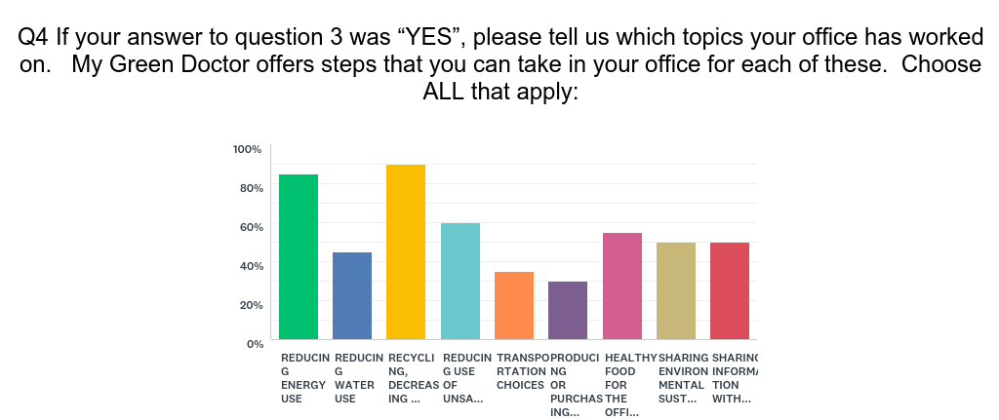

Slide 16
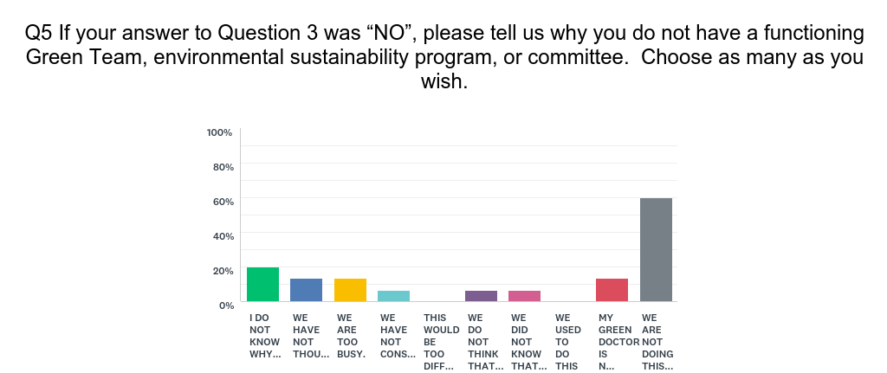

Slide 17
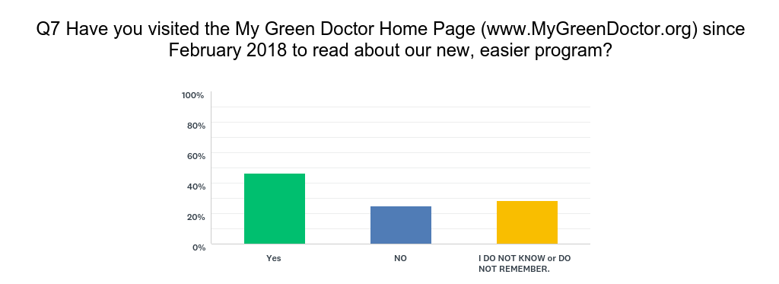

Slide 18
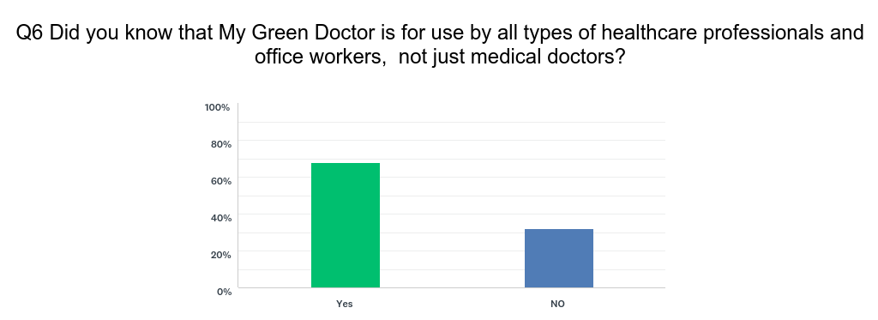

Slide 19
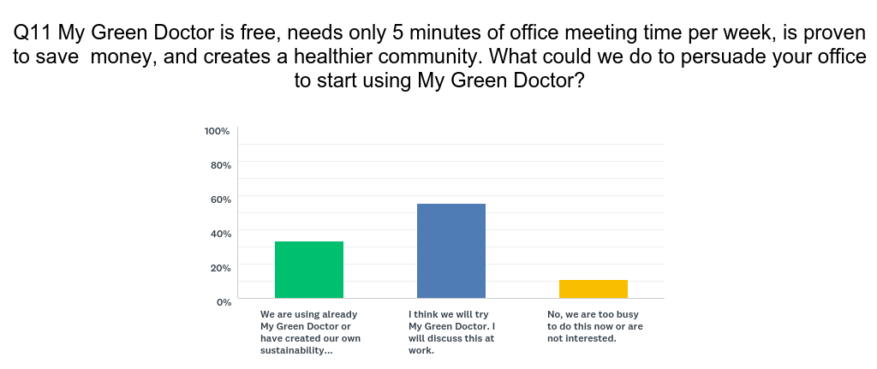

Slide 20
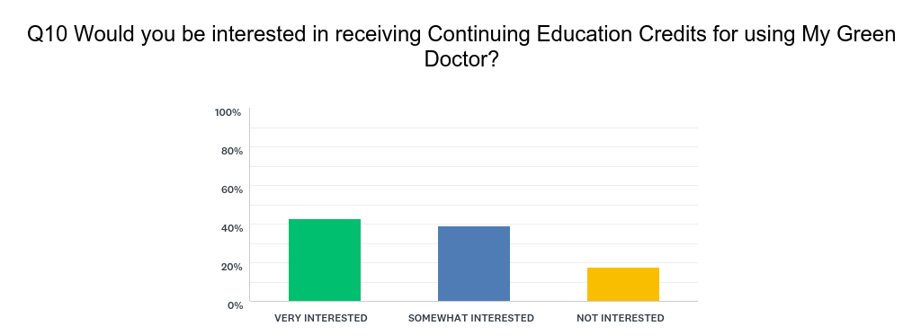

Slide 21
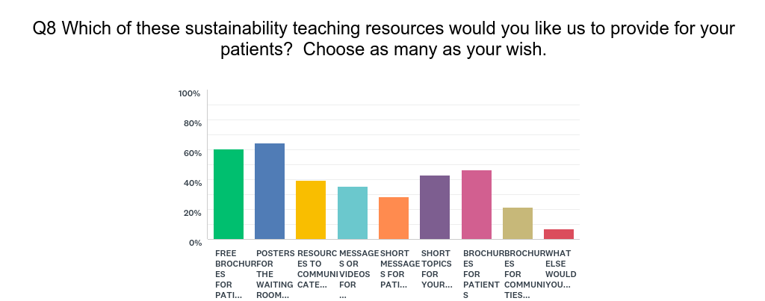

Slide 22
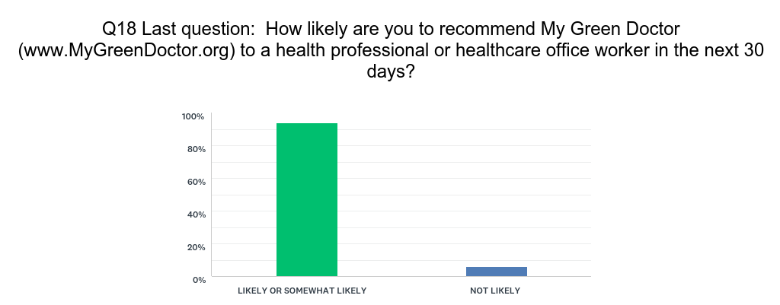

Slide 23
Our Partners & Participant Organizations
World Medical Association

Slide 24
Todd L Sack, MD, FACP Editor, My Green Doctor tsack8@gmail.com 904-403-6446
Teaching Climate Change in Healthcare Offices
Outpatient clinics & offices are ideal settings for teaching
climate change & health.
My Green Doctor is an easy & proven tool for clinics & offices.
Target audience: health professionals, office staff, patients &
families.
Health professionals are willing to lead and to teach.
Offices want educational materials.
“Thank you!”
Notes:
Weather and climate change play a significant role in our health and well-being. I’m going to discuss some health issues related to waterborne infectious disease.
There are an estimated 12-19 million outbreaks of endemic waterborne disease annually in the US., with many of the infectious agents not identified….so probably a much bigger problem.

