Slide 1
Climate Conscious Communication and Care
Cheryl L. Holder, MD
Co-Chair, Florida Clinicians for Climate Action
5/18/2020

Slide 2
Climate Impacts Health

Slide 3
Goals
Identify four health conditions affected by climate change.
Identify social determinants of health of climate change.
Name three ways of incorporating climate impacts on SDH during history taking.
Identify three ways to communicate with community on climate and health.
Identify three clinician actions to reduce the impact of climate change.

Slide 4
Case Study
Ms. Anna Mae is a 64 y.o. African American non-smoking, woman living in Opa locka, Fl with HTN, T2DM, HLD, COPD/Asthma, Obesity. Adheres to her meds-Lisinopril 20mg daily, Amlodipine 5mg daily, Metformin 1000mg twice daily, Pravastatin 80mg nightly, Aspirin 81 mg daily, Albuterol prn. She walked-in for an albuterol refill.

Slide 6
THEESEUS- A Mnemonic for Addressing SDH of Climate Change
T- Transportation (pollution and vector exposure-- public, bike, walk, car, train)
H- Housing ( weatherization, screens-protect from vectors, mold, mildew, A/C, medication storage)
E – Eating ( access, more plant based, affordability, cooking stove)
E- Education- (literacy, climate literacy, numeracy)
S- Safety ( environmental exposures in home and community, allergy season, extreme heat, and extreme weather )
E- Economics- (current and long term, budget for necessities, medications, clothing, disaster preparation)
U- Utilities (electric, gas, water, internet, phone, heating)
S- Societal Support- climate policies, family, friends, work, religious, community, recreational)
“S”- “isms”- racism, ageism, sexism etc.

Slide 7
Summarize Assessment
Ms. Anna Mae is a 64 yo woman with exacerbation of COPD/Asthma due to extreme heat, mold in home, prolonged allergy season and inability to afford air conditioning due to limited funds.

Slide 8
Plan
Revise medication management
Refer to social worker
Complete FPL form
Use Good Rx or other medication programs to provide affordable meds.
Refer home for weatherization program
Educate on avoidance of window opening during peak allergy times (5-10am and dusk)
Educate on safe ways to keep cool ( library, fill spray bottle with water and keep refrigerated etc.)

Slide 9
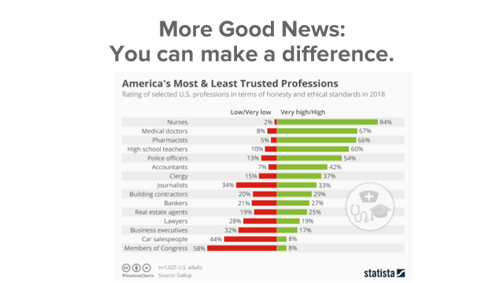
Plan
Revise medication management
Refer to social worker
Complete FPL form
Use Good Rx or other medication programs to provide affordable meds.
Refer home for weatherization program
Educate on avoidance of window opening during peak allergy times (5-10am and dusk)
Educate on safe ways to keep cool ( library, fill spray bottle with water and keep refrigerated etc.)

Slide 10
How to Talk About Climate and Health
Keep it simple.
Keep it local.
Keep it hopeful.
And tell stories.

Slide 11
How Health Changes the Climate Narrative
1
2
It’s happening here
3
It’s harming our health
It’s happening now
Climate Matters Media Library at ClimateCentral.org

Slide 12
Keep it local: What are your community risks?
cdc.gov/climateandhealth

Slide 13
Three Actions Health Professionals Can Take To Advocate for Climate Solutions:
Educate about climate change to patients, family, friends, colleagues, community, and lawmakers. Write OpEds and letters to editor.
Advocate- Join an organization advocating for solutions to climate change.
Florida Clinicians for Climate Action (FCCA) www.FloridaClinicians.org
Alliance of Nurses for Healthy Environments (ANHE) https://envirn.org/
Engage- Learn more about climate solutions and involve colleagues in actions like Project Drawdown and My Green Doctor
Drawdown Ecochallenge https://drawdown.ecochallenge.org/
Mygreendoctor.org

Slide 14
Plan
Revise medication management
Refer to social worker
Complete FPL form
Use Good Rx or other medication programs to provide affordable meds.
Refer home for weatherization program
Educate on avoidance of window opening during peak allergy times (5-10am and dusk)
Educate on safe ways to keep cool ( library, fill spray bottle with water and keep refrigerated etc.)

