Slide 1
Global Consortium on Climate and Health Education
gcche.mailman.columbia.edu

Slide 2
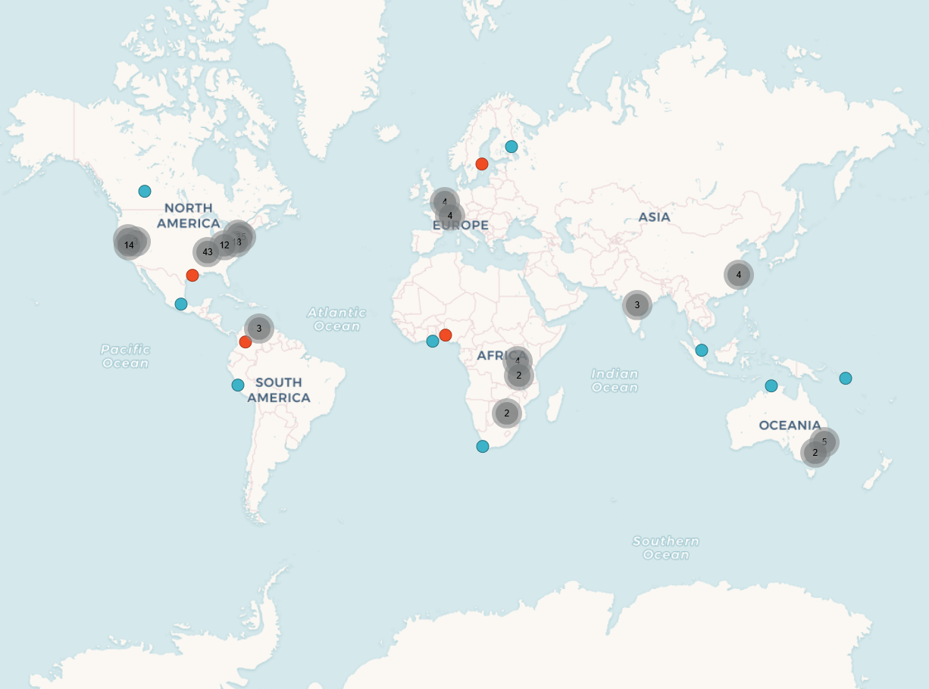
Global Network
15 countries
6 continents
~200 members
150,000+ students
~30 countries

Slide 3
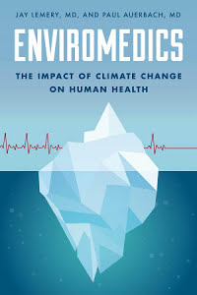
Knowledge Bank

Slide 4
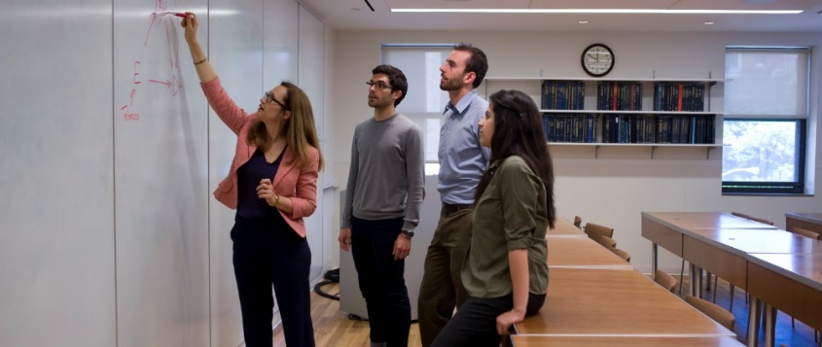
Developing Global Standards for Knowledge & Practice

Slide 5
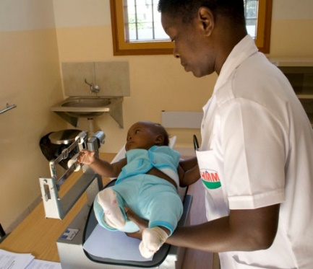
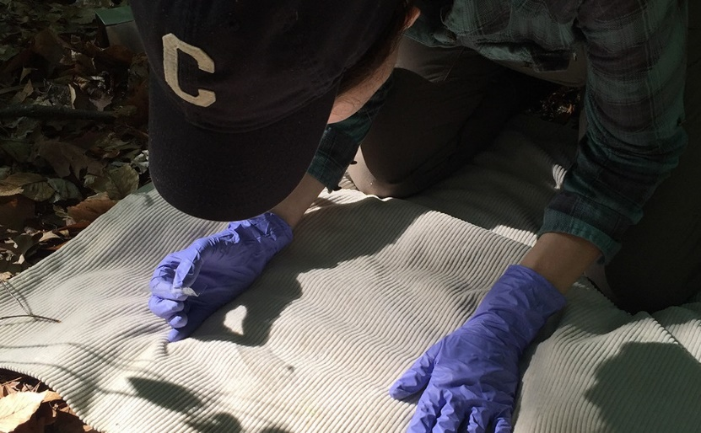
Sharing Strategies & Best Practices
Infusion into existing courses
Electives
Fellowships
Projects for students

Slide 6
Thank you!
Acknowledgements: The Medical Society Consortium on Climate and Health; ClimateWorks Foundation; Rockefeller Foundation; GCCHE Advisory Council, Coordinating Committee, & members; Dr. Jeffrey Shaman, Dr. Kim Knowlton; Columbia University Mailman School of Public Health Dean’s office
Contact: Brittany Shea, MA
GCCHE Project Director
bes2161@cumc.columbia.edu
gcche.mailman.columbia.edu

