Slide 1
Adrienne Wald, EdD, MBA, RN, MCHES, CNE Associate Professor of Nursing, Mercy College, New York Co-chair, Alliance of Nurses for Healthy Environments (AHNE) Global Climate Change Committee WELCOME
Connecting Environmental Justice to Health
Fancybox
Wellness at Mercy College
The Mercy College Wellness Team is here for every student, anytime, across all of our campuses and locations.

Slide 2
Objectives
Define Environmental Justice
Connect the Environmental Justice Movement and Health
Exemplars from the Alliance of Nurses for Health Environments (AHNE) Inaugural Environmental Nurse Fellowship Program

Slide 3
Defining Environmental Justice
Environmental Protection Agency (EPA):
“Environmental justice (EJ) is the fair treatment and meaningful involvement of all people regardless of race, color, national origin, or income with respect to the development, implementation, and enforcement of environmental laws, regulations, and policies… it will be achieved when everyone enjoys the same degree of protection from environmental and health hazards and equal access to the decision-making process to have a healthy environment in which to live, learn, and work.”

Slide 4
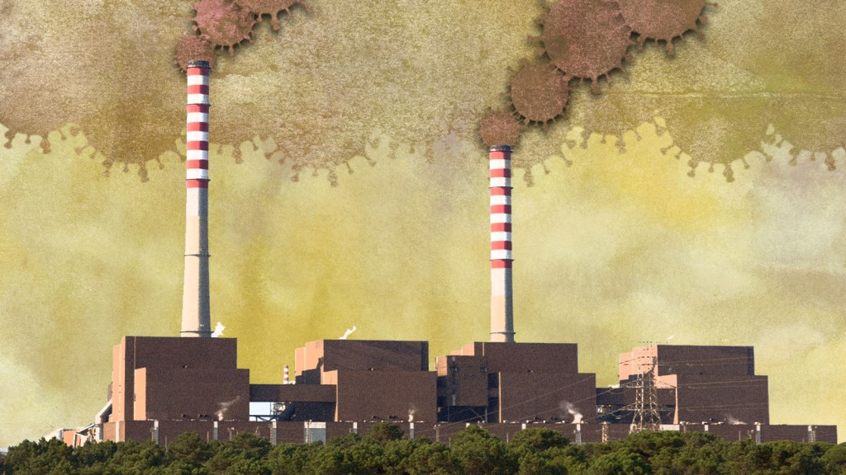
GRIST LONG TIME COMING Coronavirus is not just a health crisis — it’s an environmental justice crisis By Yvette Cabrera on Apr 24, 2020
Grist / © Santiago Urquijo / Getty Images
Environmental
Justice and Health?
Grist / © Santiago Urquijo / Getty Images

Slide 5
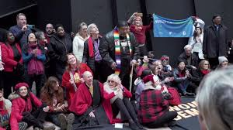
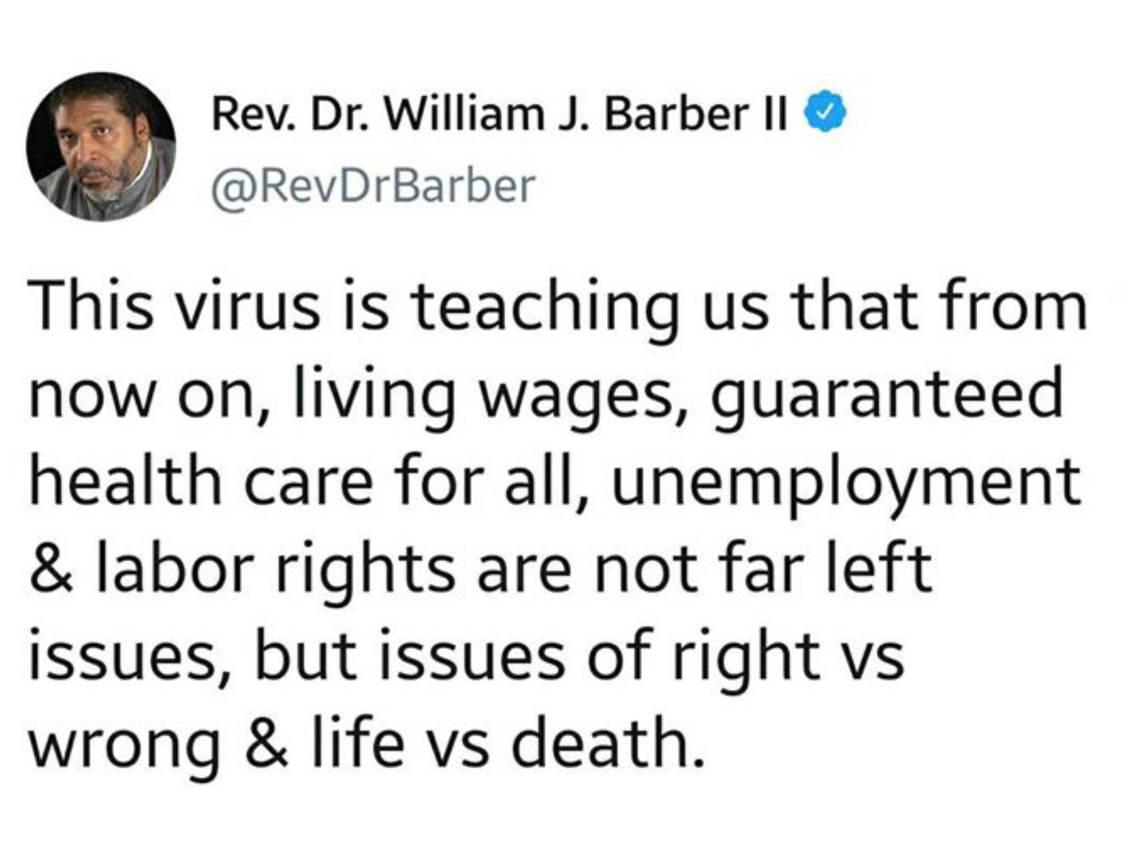
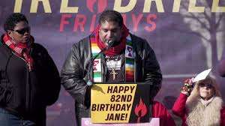
https://www.facebook.com/watch/live/?v=574669383364301&ref=watch_permalink

Slide 6
Authors: Rachel Kerr, DNP, RN Cara Cook, MS, RN, AHN-BC Katie Huffling, MS, RN, CNM, FAAN
Introduction - The ANHE Environmental Health Nurse Fellowship program as a valuable model for:
Relationship-building between nurses and communities
Training nurses in climate change, environmental health (EH)/environmental justice (EJ), and community engagement
Enhanced community resilience and health equity through nurse-community partnerships

Slide 7
Background/Need
Climate-related disasters and pollution increasingly affect vulnerable communities
Need for nationwide network of nurses prepared to help address EH/EJ/climate issues in communities as they arise
Need for nurses to serve as resources and advocates:
Around climate change and EH
In partnership with communities
Communicating with media and decision-makers

Slide 8
Fellowship Details and Structure
30 nurse fellows, 10 nurse mentors
Monthly webinars around EH/EJ topics, 2 in-person meetings
Community forum via Slack
Partner with community-based organizations to address a community-identified EH/EJ need
Support community-driven solutions
Educate health professionals about their fellowship work
https://kresge.org/CCHE
Learn more: https://envirn.org/anhe-fellowship/

Slide 9
Fellowship Projects
Baton Rouge, LA – Nurse fellow organized emergency preparedness training for older adults to enhance resilience to climate disasters
Chico, CA – In a community impacted by the Camp Fire, nurse fellow implemented program to assess/address access to clean drinking water and mental health resources
San Juan, PR – In a community impacted by Hurricane Maria, nurse fellow working with local schools to improve response to poor air quality and other EH concerns

Slide 10
Future Directions
Plan for future nurse fellowship cohorts
Continued growth of movement of nurses tackling climate change and EH in partnership with communities
Potential for enhanced community resilience to future climate-related disasters and impacts
Increased awareness of climate justice and EH/EJ among nurses

Slide 11
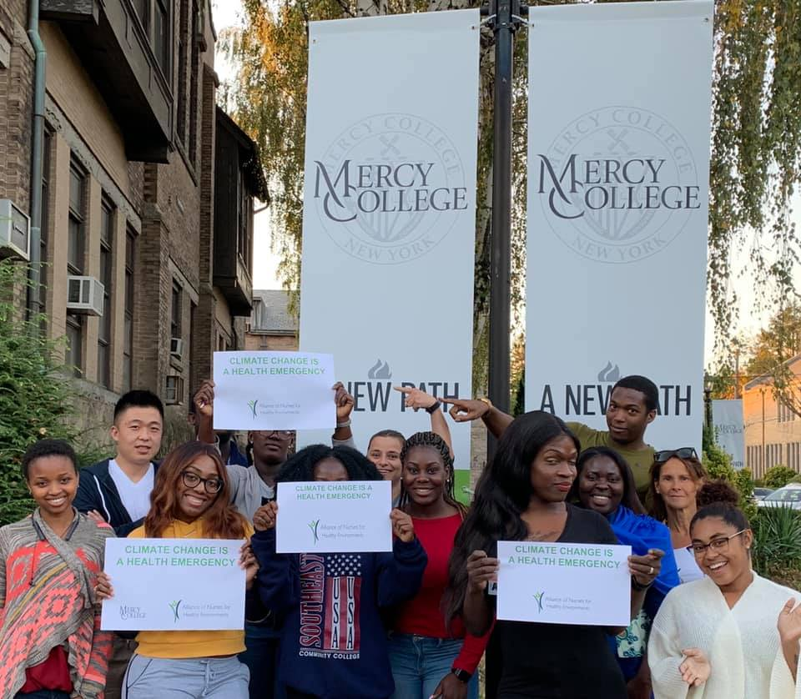
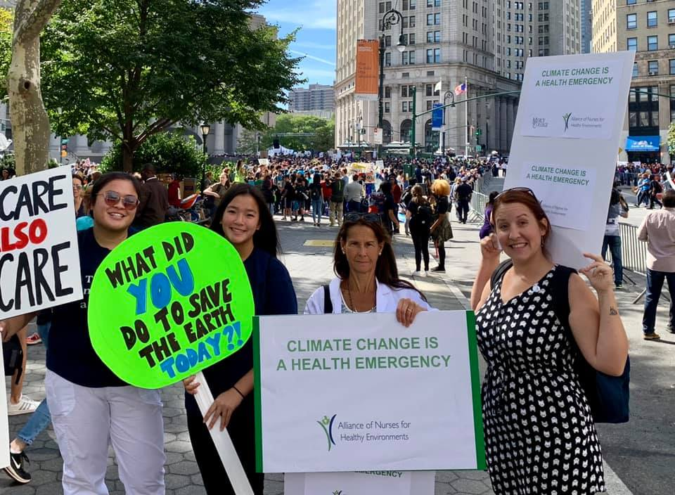
WHY the Health Professions? Why Students?

Slide 12
Summary Message: Be an EJ Advocate & Activist
Contact policy makers
Write editorials and opinion pieces
Collaborate with partner organizations
Give talks and presentations

Slide 13
Op ed by ANHE Fellow Aaron Salinas highlights why the U.S. Environmental Protection Agency must ensure strong environmental protections to protect communities most vulnerable, such as the Rio Grande Valley, to COVID-19 and the climate crisis via The Monitor.

Slide 14
TIMESUNION.COM
Viewpoint: Honor nurses by enacting safe staffing regulations
By Adrienne Wald
The year 2020 started out as a notable one for nurses: This May 12 will mark the 200th...
The year 2020 started out as a notable one for nurses: This May 12 will mark the 200th...
"Enacting legislation to ensure safe nurse-patient staffing ratios would honor 2020 as the "Year of the Nurse and show real gratitude for nurses' contributions, and lead to a better health care system that serves all. Moving forward after this profound crisis, let us also commit to reexamining our overburdened and underfunded public health and health care systems to better address its inequities and injustices."

Slide 15
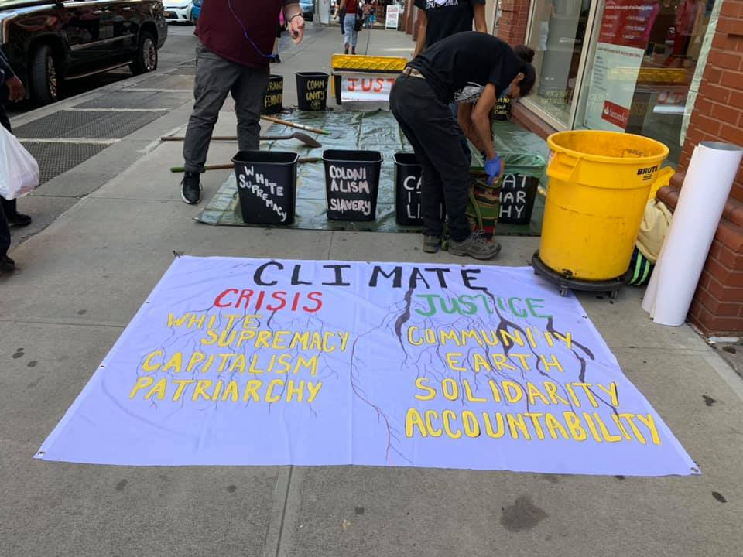
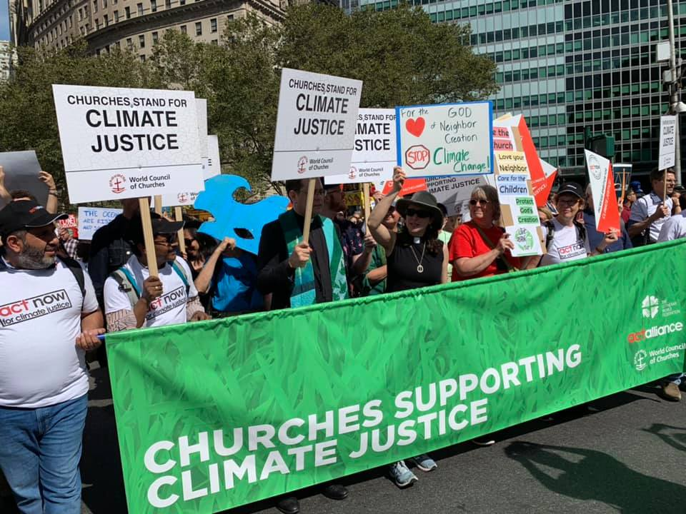
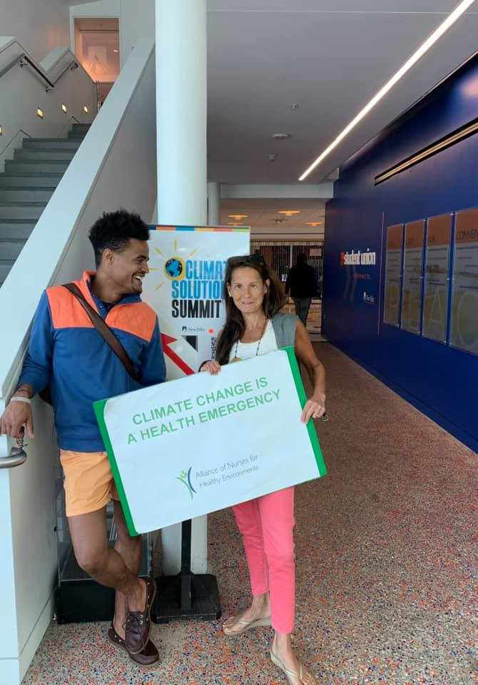
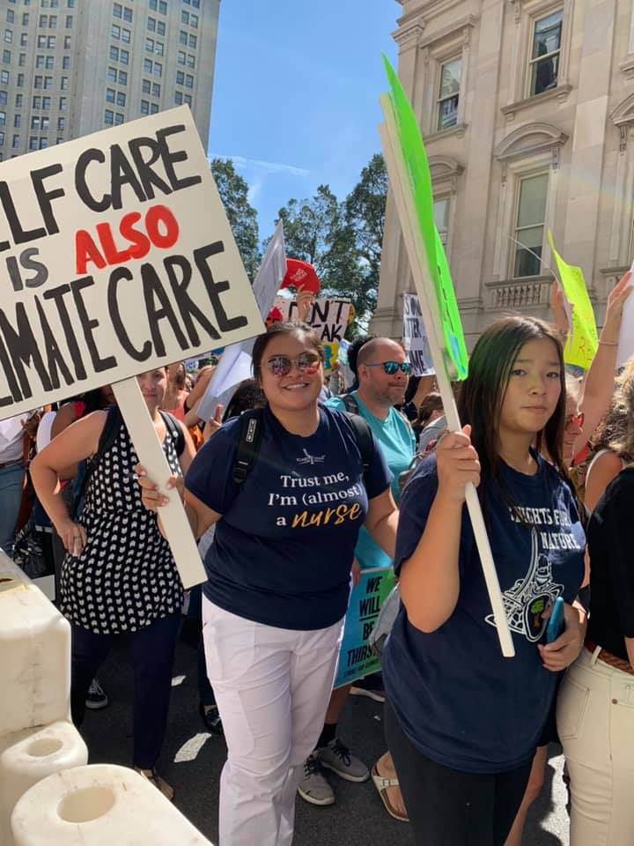

Slide 16
A NATIONAL CALL FOR MORAL REVIVAL
MASS POOR PEOPLE’S ASSEMBLY & MORAL MARCH ON WASHINGTON
Saturday, June 20, 2020
Online
TAKE ACTION WITH US!
A NATIONAL CALL FOR MORA

Slide 17
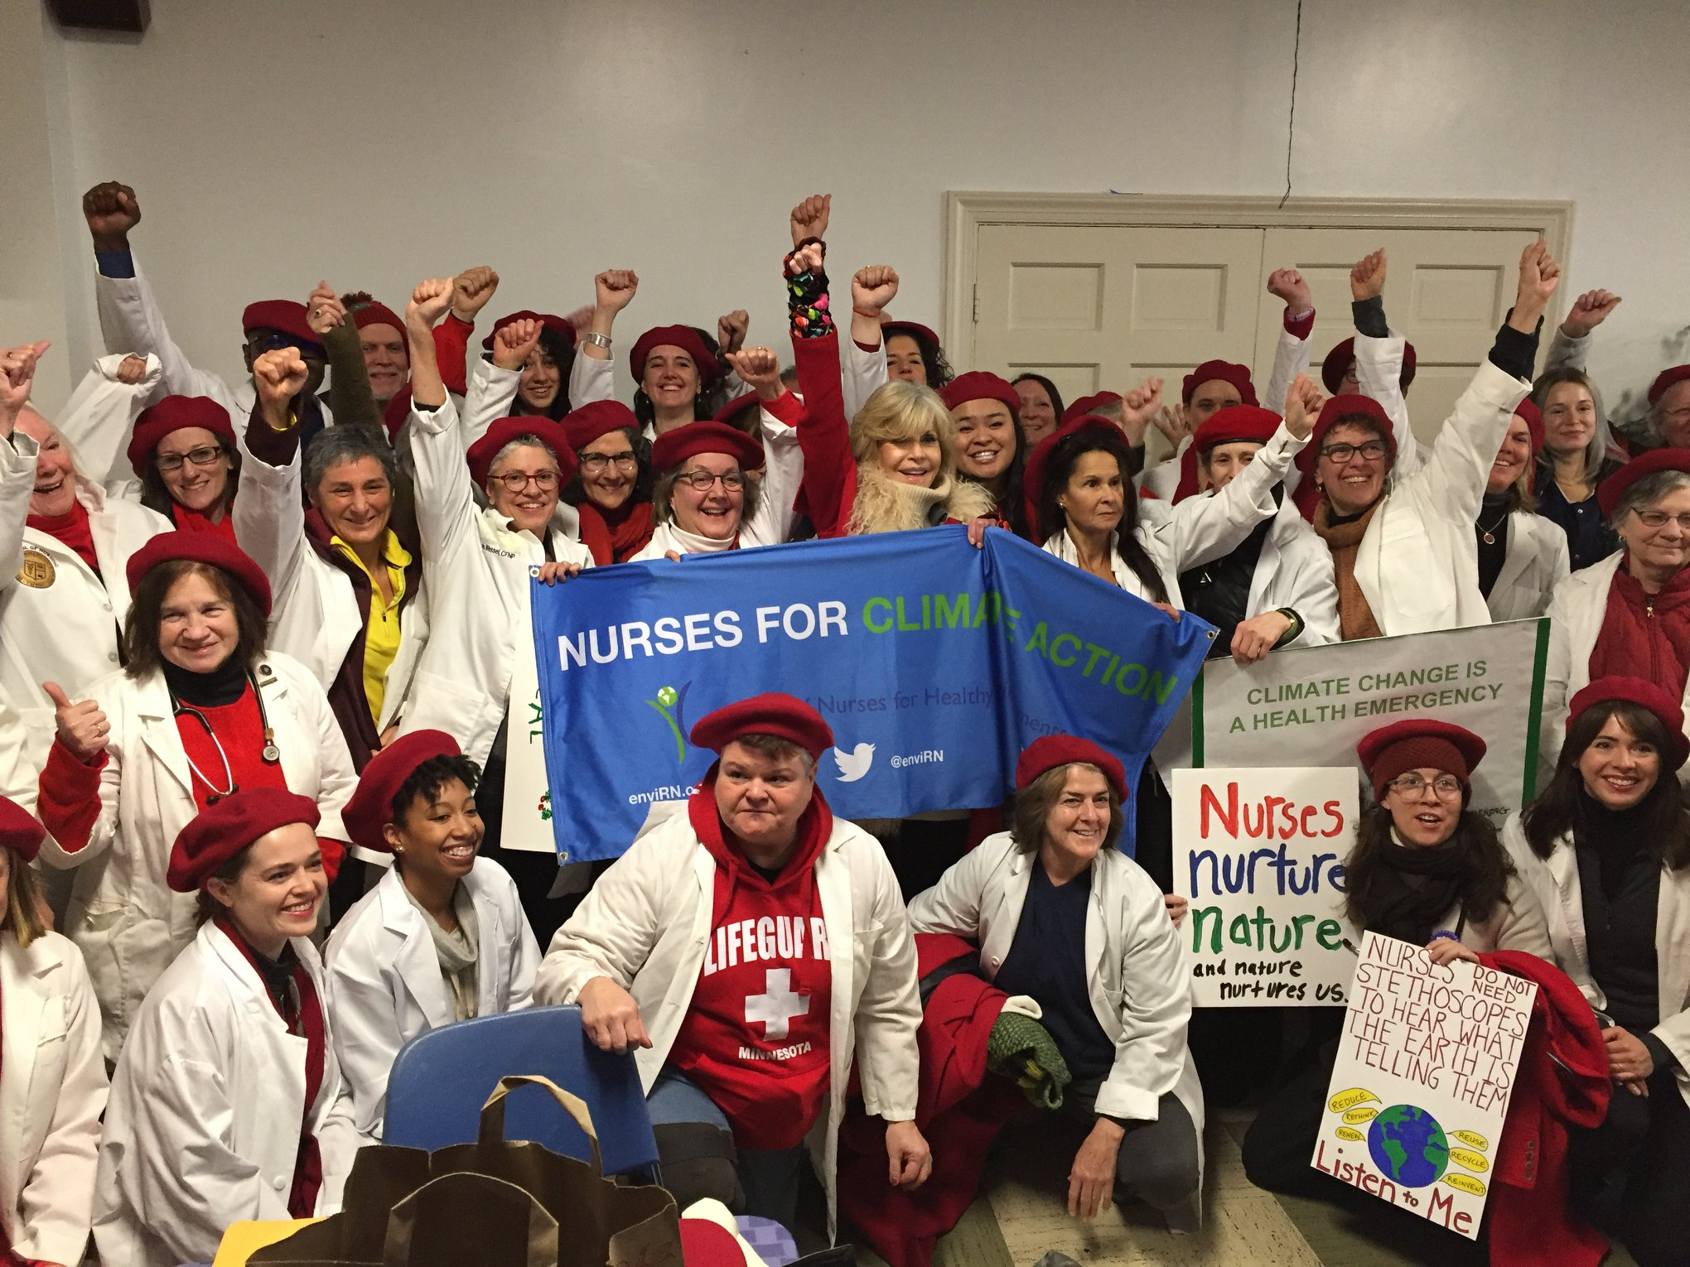
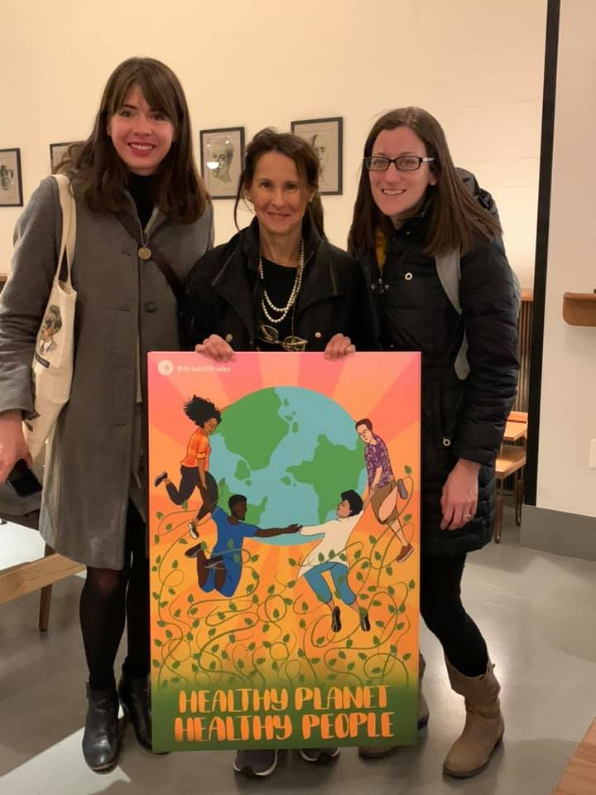
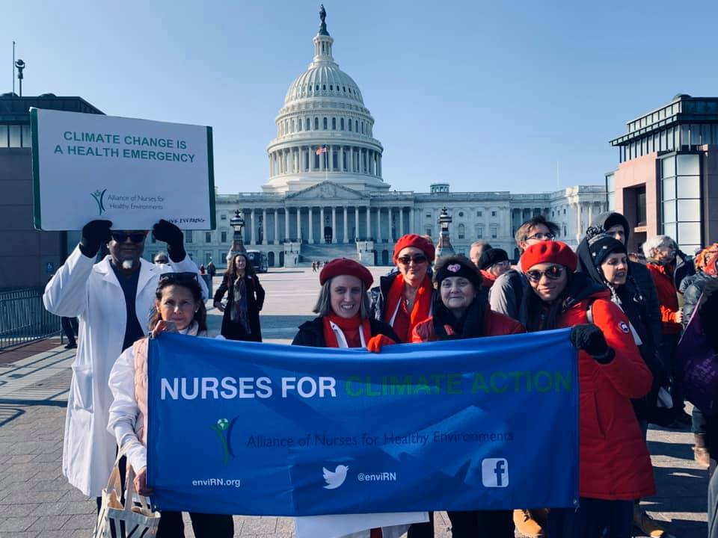
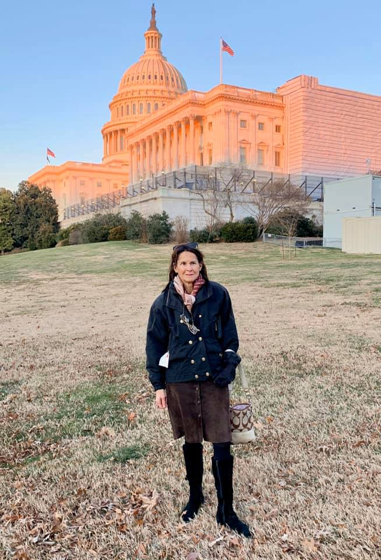
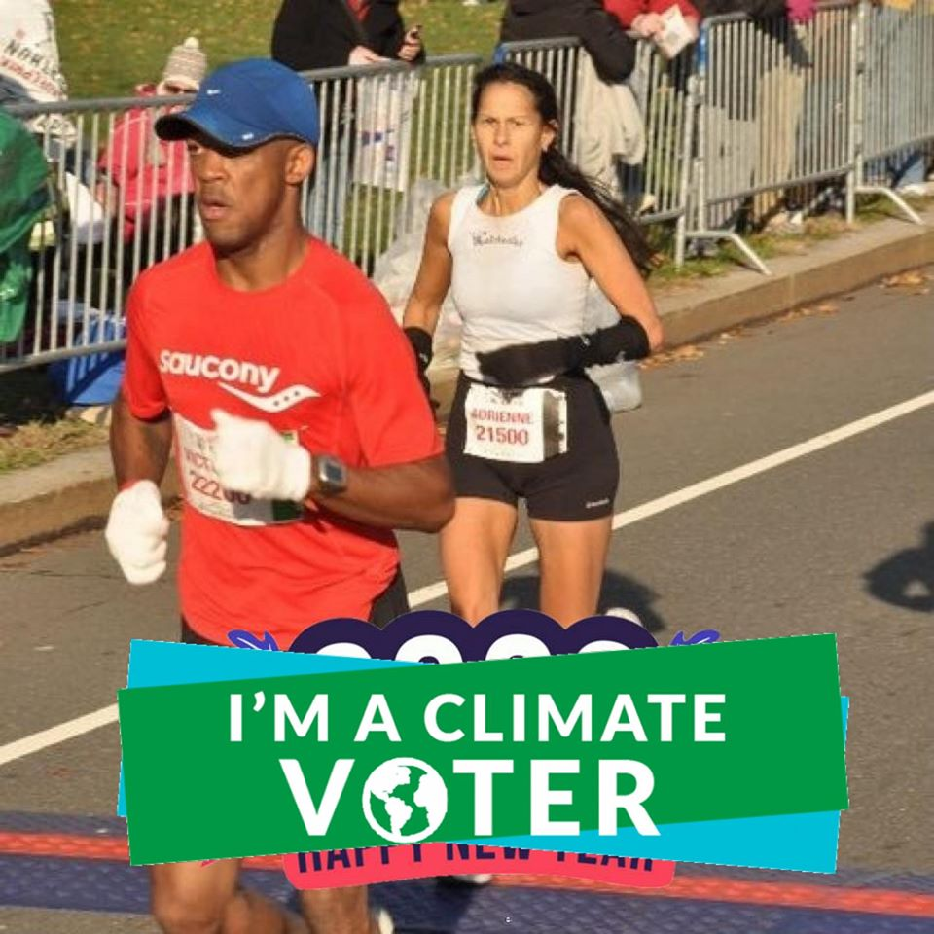
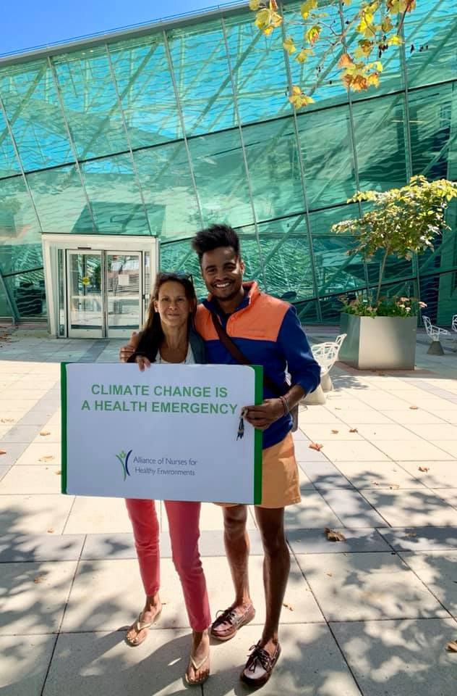
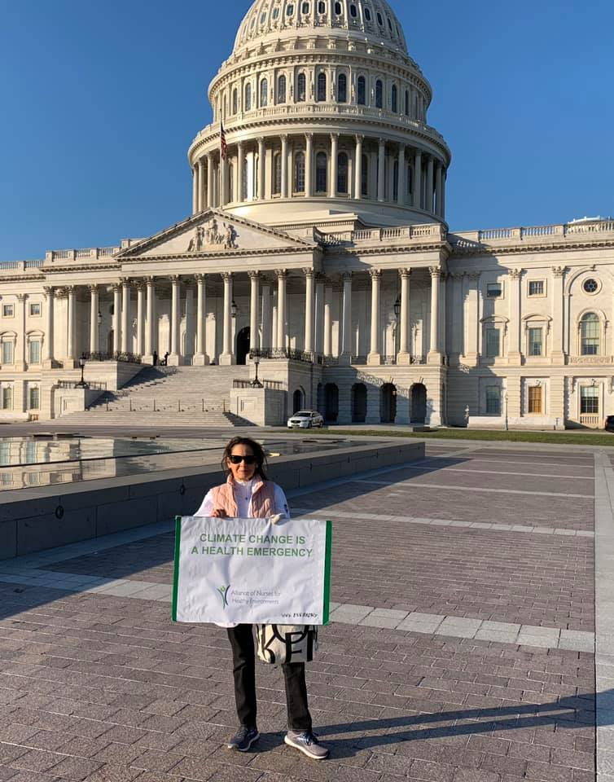
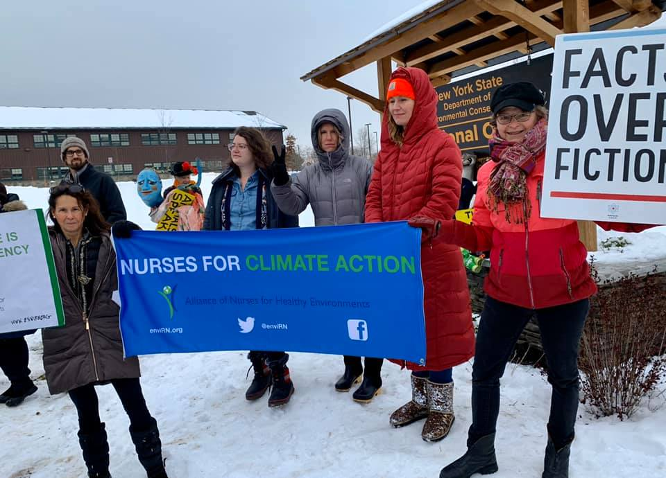
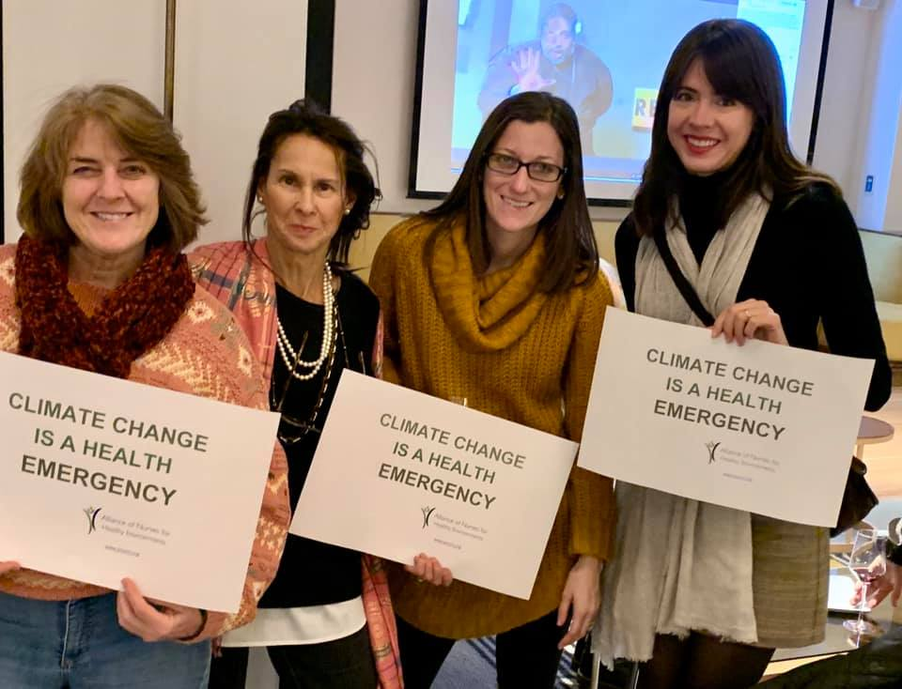

Slide 18
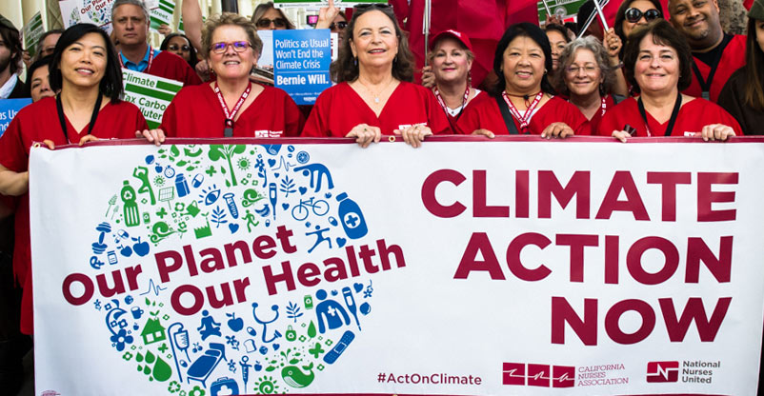
Environmental & Climate Justice Organizations and Resources
Alliance of Nurses for Heathy Environments https://envirn.org/
Clean & Healthy New York https://www.cleanhealthyny.org/
EPA EJ 2020 www.epa.gov/environmentaljustice/ej-2020-action-agenda-epas-environmental-justice-strategy
Fire Drill Fridays https://firedrillfridays.com/
National Nurses United www.nationalnursesunited.org/environmental-justice
Poor Peoples Action Campaign www.poorpeoplescampaign.org/
Vote Earth https://www.earthday.org/campaign/vote-earth/
West Harlem Environmental Action (WE ACT) https://www.weact.org/

