Slide 2
Established – January 27, 2018
The Climate Health & Equity Symposium

Slide 3
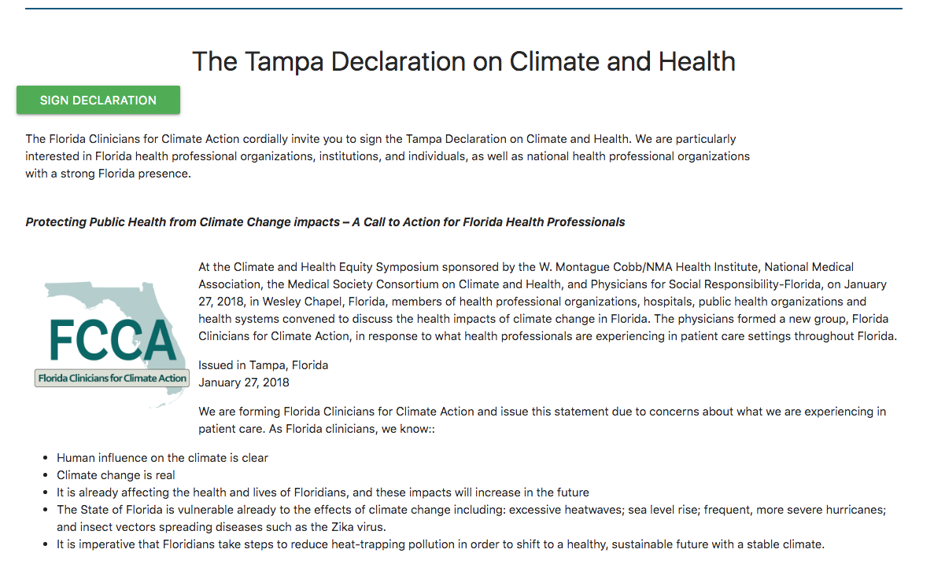
www.FloridaClinicians.org

Slide 4
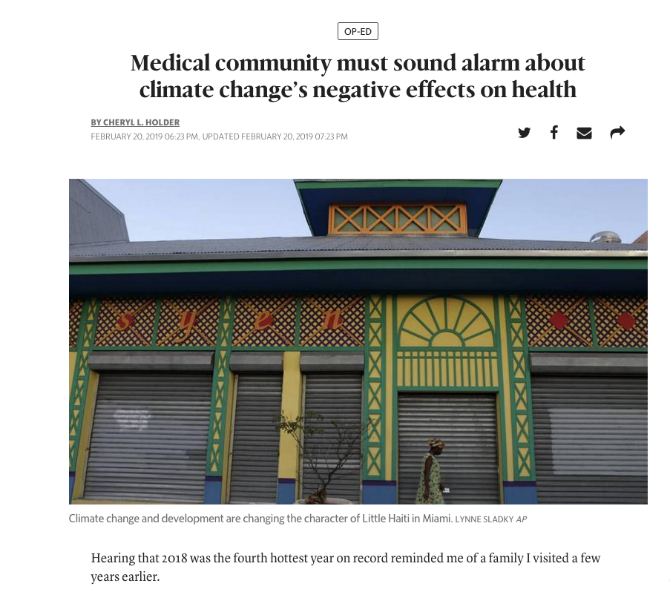
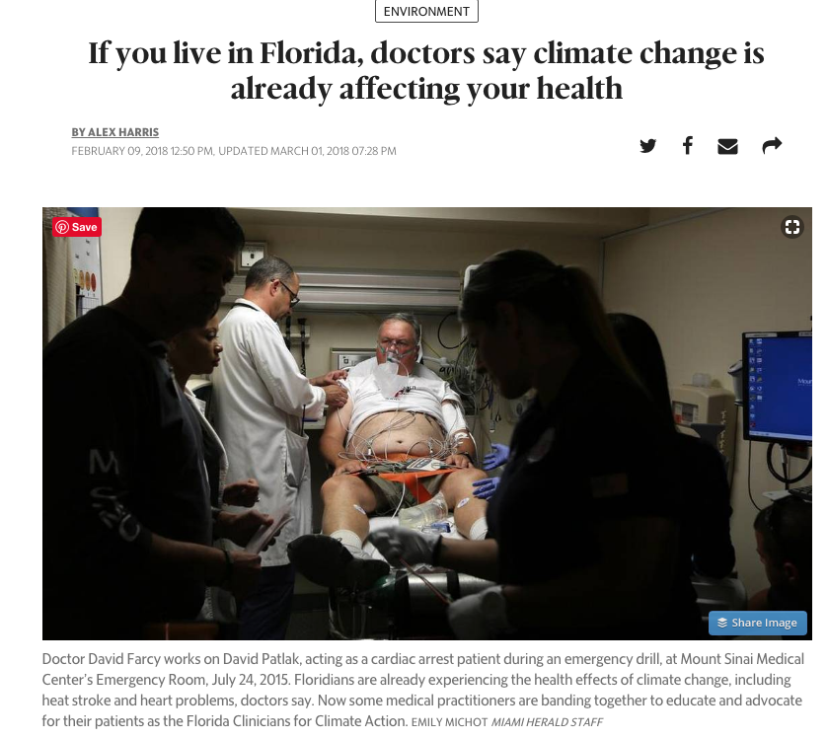
In The News…

Slide 5
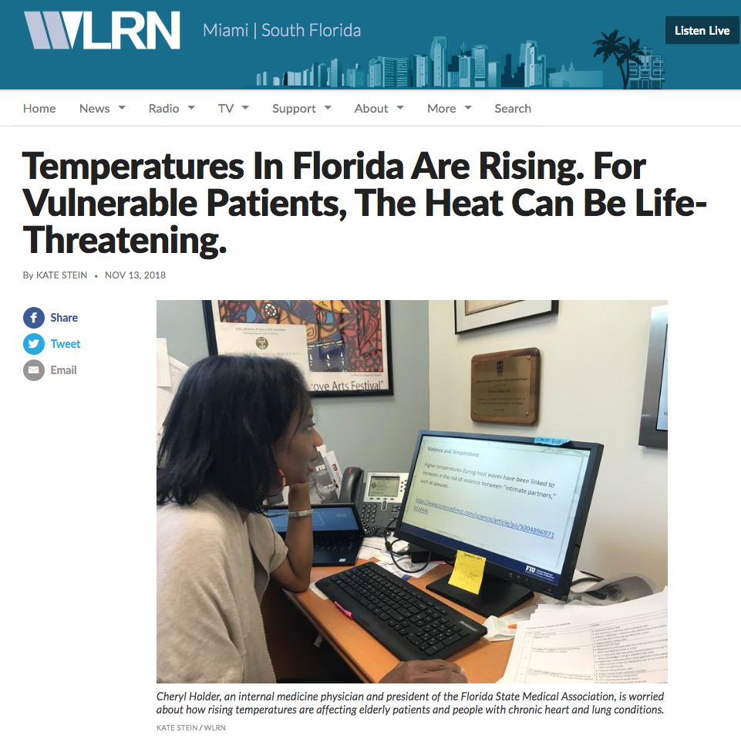
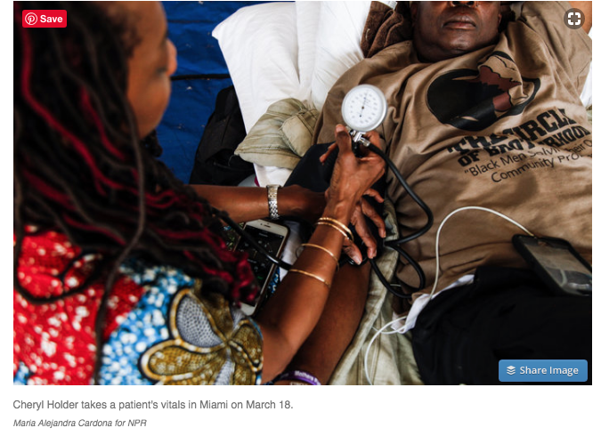
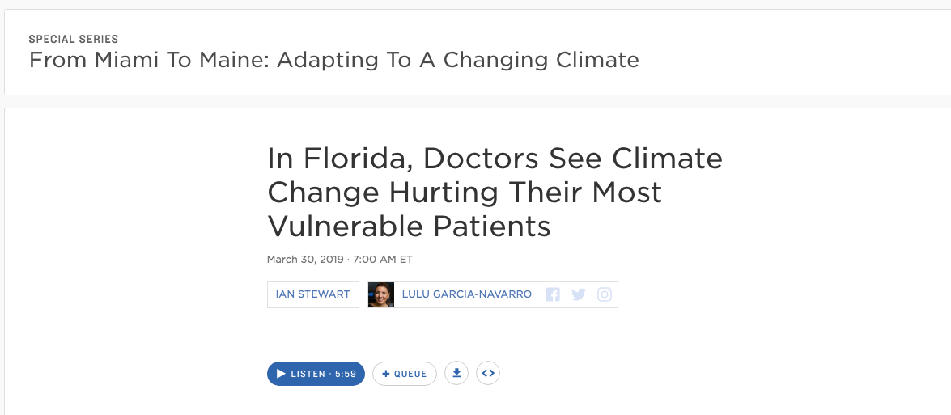
In The News…

Slide 6
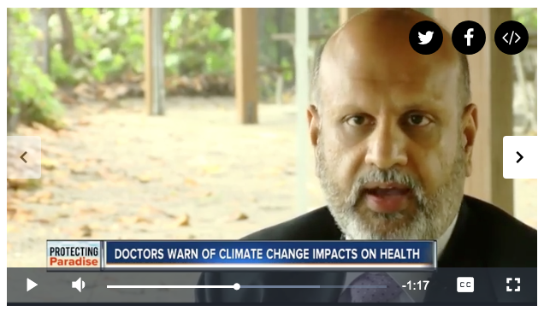
In The News…

Slide 8
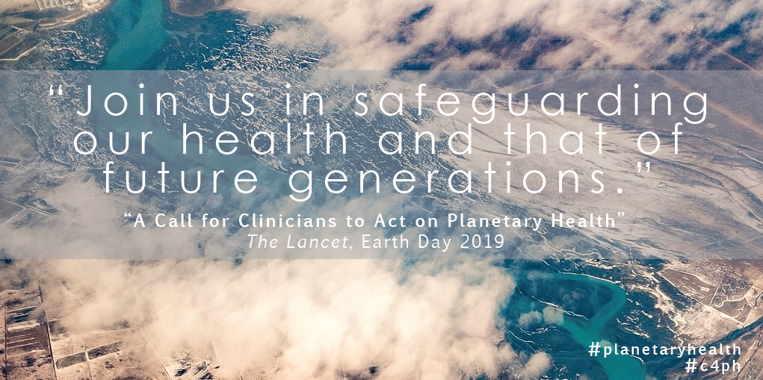
A Call for Clinicians to Act on Planetary Health
Co-Chair Ankush Bansal a member of the working group published in the Lancet (4/19/2019)

