Slide 1
Building Mental Health for Vulnerable
Populations in a Time of Crisis
COVID-19, Climate Change, and Equity The Medical Society Consortium of
Climate & Health
May 18, 2020
Annelle Primm, MD, MPH
All Healers Mental Health Alliance
(AHMHA)

Slide 2
All Healers Mental Health Alliance
A national multidisciplinary group of physicians, mental health professionals, health advocates, faith leaders, and first responders
Facilitates culturally appropriate, long-term responses to the mental health needs of marginalized communities in the aftermath of disaster

Slide 3
What We Do
Twice monthly teleconference forums for information exchange, resource-sharing and technical assistance for community leaders post-disaster
Mobilize collaborations for local healing, resilience, and support services for disaster affected communities, caregivers and first responders

Slide 4
Disasters of Focus
Hurricane Katrina, New Orleans and Gulf Coast
Superstorm Sandy, New York City
Hurricane Irma and Maria, U.S. Virgin Islands
Hurricane Harvey, Houston and Port Arthur, TX
Hurricane Florence, North Carolina and South Carolina
Hurricane Michael, Florida Panhandle
COVID-19

Slide 5
Maximizing Mental Health Post-Disaster
Calm
Safety
Self and collective efficacy
Connectedness
Hope
Hobfoll S. E, Watson P, Bell C. C, Bryant R. A, Brymer M. J, Friedman M. J, et al. Five essential elements of immediate and mid-term mass trauma intervention: Empirical evidence. Psychiatry. 2007;70:283–315.

Slide 6
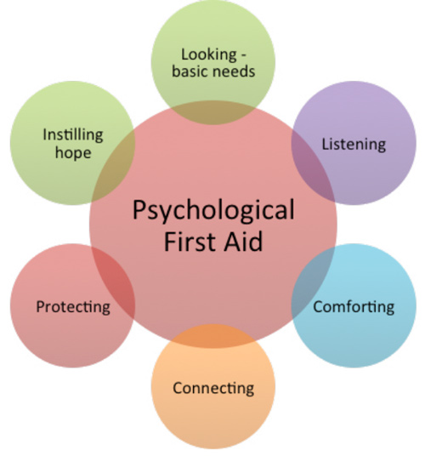
Hurricane Florence
Courtesy of Toni Johnson, MD
Former Vice Chair of Psychiatry
Eastern Carolina University School of Medicine

Slide 7
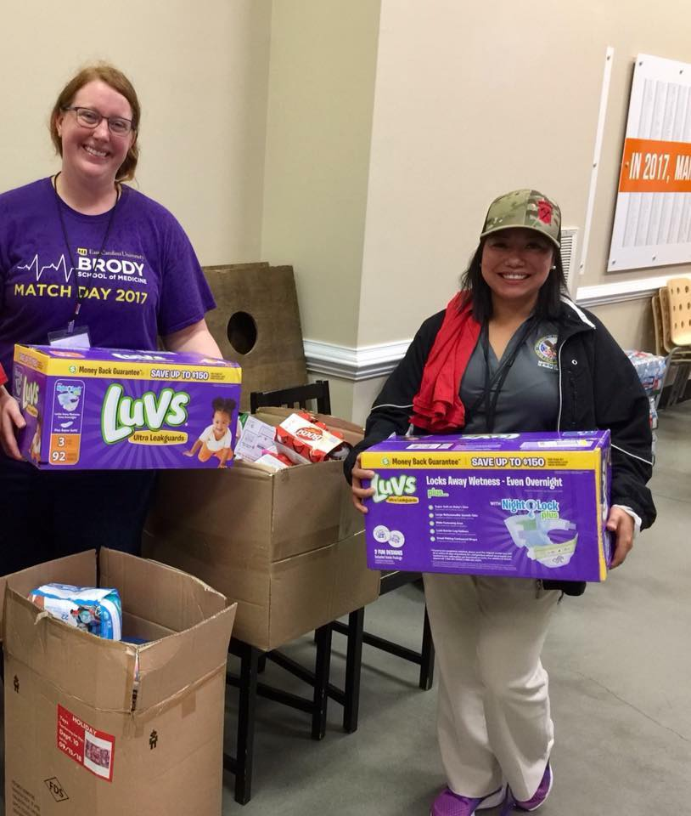
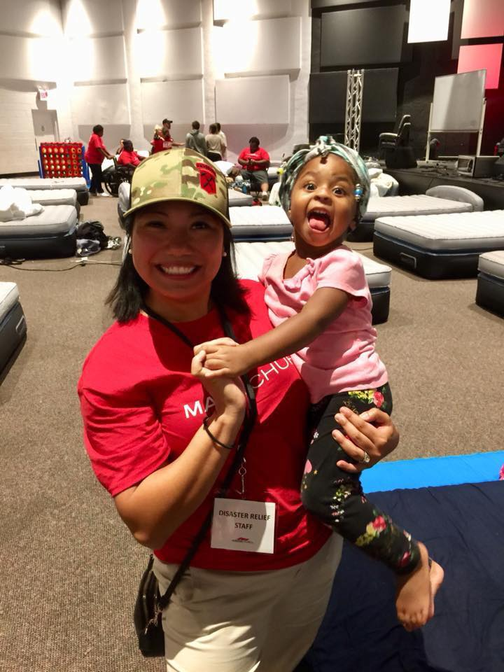
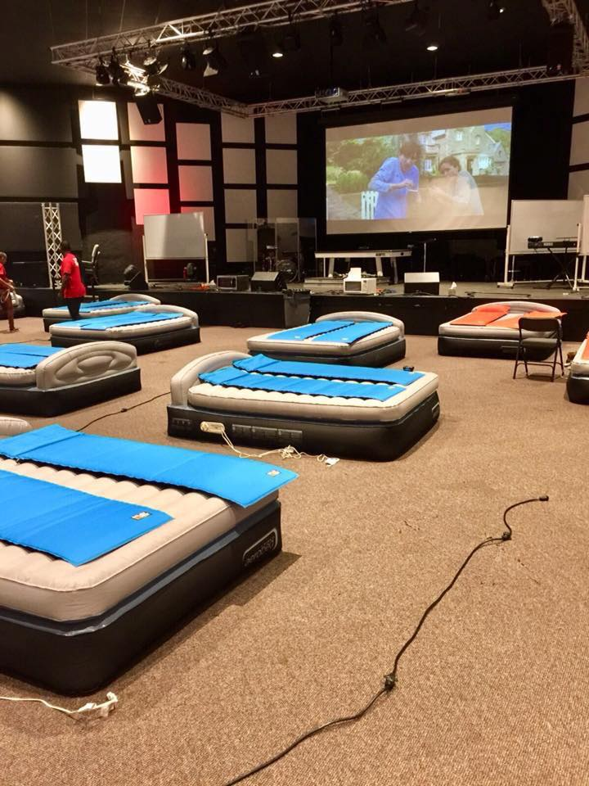
Early interventions, such as PFA, can help provide a positive recovery environment for disaster survivors
Courtesy of Toni Johnson, MD
Former Vice Chair of Psychiatry
Eastern Carolina University School of Medicine

Slide 8
Key Takeaways
Given the increase in disasters including those related to climate change, clinicians cannot afford not to have adequate training in this area.
Serving can create an excellent opportunity to connect with the local communities long after the disaster has ended.
Partnering with other agencies and disciplines is the recipe for success.
Never underestimate the power of compassion in action.
Courtesy of Toni Johnson, MD
Former Vice Chair of Psychiatry
Eastern Carolina University School of Medicine

