Slide 1
Climate and Health: The Case for High-Performance Buildings
Medical Society Consortium on Climate and Health Annual Meeting, April 2019
Notes:
Image size: 4.58” high x 10” wide

Slide 2
Climate and Health: Why Buildings Matter
2011 Total Primary Energy Use (Quadrillion BTU)
Notes:
Connect energy use to carbon emissions to climate
Source: RMI, Reinventing Fire
http://www.10xe.orwww.10xe.org/RFGraph-US_building_energy_use

Slide 3
Climate and Health: Why Buildings Matter
Nationwide annual impacts of reducing electricity consumption by 15%:
More than six lives saved each day
Up to $20 billion in avoided health harms
$70 in health savings per person
Nearly 30,000 fewer asthma episodes
Notes:
An analysis by ACEEE and Physicians for Social Responsibility found that by reducing NOx, SO2, and PM_{2.5} emissions from power generation, a 15% reduction in national electricity consumption could have the following impacts for a single year
https://ifmt.app.box.com/file/369447570812
ALSO
1/3 of low-income households in California have cut back on food in order to pay utility bills.
16% of low-income households in California reported someone got sick because they couldn’t heat their home at 1/20 experienced heatstroke or illness due to lack of cooling.
Source re: low-income: Utility Reform Network (TURN). Surveyed low-income households in CA in a report focusing on impact of utility shutoffs.

Slide 4
Climate and Health: Why Buildings Matter
Mental function, memory 10-25% better
Hospital stays 8.5% shorter
Test scores 5-14% higher
Retail sales up 15-40%
Worker productivity up 18%
Productivity gains:
+23% from lighting
+11% from ventilation
+3% from individual temperature control
Shown: net present value analysis of the operational cost and productivity and health benefits of LEED-certified buildings. Source: World Green Building Council
Notes:
All from World Green Building Council report, page 67: https://www.worldgbc.org/sites/default/files/Business_Case_For_Green_Building_Report_WEB_2013-04-11-2.pdf
Net present value analysis of the operational cost and productivity and health benefits of LEED certified buildings
Left: outside views
Middle: Daylight
Right: Productivity gains
In 2016 alone, ENERGY STAR saved Americans $30B in energy costs and prevented 320 million metric tons of carbon emissions

Slide 5
What is a High-Performing Building?
Contributes to the health, safety, comfort, and productivity of occupants;
Uses energy, water, and other resources efficiently;
Incorporates advanced energy solutions;
Is capable of self-sufficiency or actively contributes to electric grid resilience.
Notes:
Sweetwater Spectrum in Sonoma, CA. By Leddy Maytum Stacy Architects. the 2.8-acre site provides a permanent home for 16 adults with autism and their support staff.
LEED Gold, the project is also a PG&E Zero Net Energy Pilot Project and is designed to produce onsite all the energy required to operate the buildings.

Slide 6
Bold Action on Climate at the Local Level
3,500+ signatories, including 286 cities and counties, 10 states, 2100+ businesses and investors.
100 cities committed to 100% clean and renewable energy.
19 cities pledging to cut greenhouse gas emissions 80%-100% by 2050 or sooner.
19 cities commiting to all new buildings being net-zero carbon by 2030, 12 cities commiting to owning, occupying, developing only net-zero carbon assets by 2030.
Notes:
Carbon Neutral Cities Alliance, project of USDN. USDN has 200 member commitees (cities and counties) across US and Canada

Slide 7
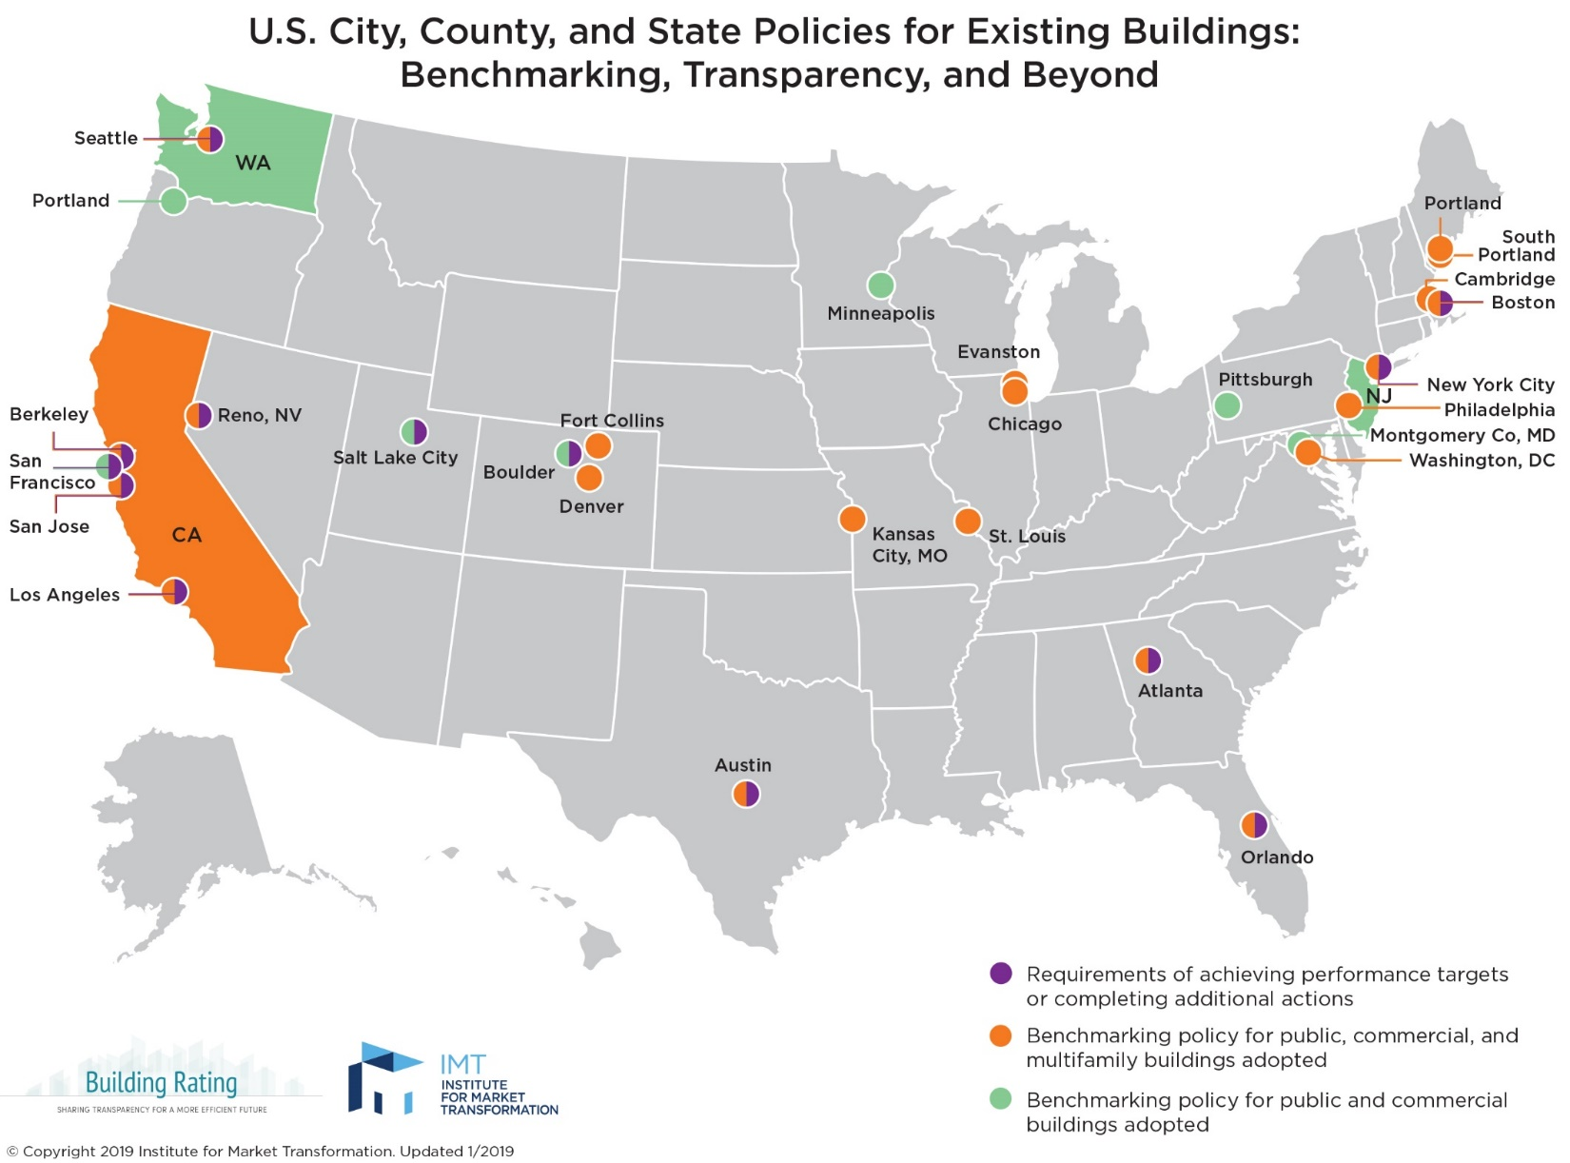
Building Performance Policy
Notes:
Can’t manage what you don’t measure. Providing data to drive action on efficiency and helpful to understand health connection.
NY MF building example with ER visits

Slide 8
Medical Professionals’ Opportunity in Building Performance Policy
Boston
2013 Building Energy Reporting and Disclosure Ordinance
Salt Lake City
2017 Energy Benchmarking & Transparency Ordinance
Notes:
When Boston was debating its benchmarking law back in 2013, a leader from a local hospital made an impassioned plea at a key public meeting to focus on the health impacts of energy consumption and support the bill. It was described to me as a turning point in the meeting. Health Care Without Harm was involved.
SLC officials estimate that the ordinance would save local buildings owners $15.8 million in annual energy costs and eliminate over 29 tons of criteria pollutants from Salt Lake City’s air each year.

Slide 9
Next-Gen Local Building Performance Policies – Washington, DC
Clean & Affordable Energy Act of 2008
Population up 16%
Electric use down 1.5%
Large bldg. energy use down 10%
Clean Energy DC Act of 2018
RPS of 100% by 2032
Building Energy Performance Standard
Cuts citywide emissions by 40% by 2032
Notes:
It mandates a renewable portfolio standard of 100% by 2032, meaning that by that date, all electricity purchased in the District must be renewable. This beats other existing state and city mandates by a decade. Cutting citywide emissions by 40% by 2032 = biggest climate impact in relative terms.
In addition, it includes a Building Energy Performance Standard that is the first time legislation will require a broad swath of existing buildings to improve their whole-building energy performance. How it will work, exactly, will be fleshed out more during rule making processes ahead. Our Executive Director, Cliff Majersik, was very involved in the BEPS element of this legislation.
Started with grassroots push on price for carbon that failed but that helped to create momentum for more impactful suite of policies. Mandatory requirements that wide swath of existing buildings meet

Slide 10
Next-Gen Local Building Performance Policies – New York City
New York City committed to cutting its greenhouse gas emissions 80% by 2050
Buildings account for 67% of emissions
Climate Mobilization Act of 2019
Requires large buildings to cut greenhouse gas emissions 40% by 2030 and 80% by 2050
Will prevent 43 premature deaths and 107 ER visits annually by 2030
Notes:
The biggest climate impact of any city in absolute terms
Will lead to $4b investment in buildings

Slide 11
Medical Professionals’ Opportunity in Building Performance: Walk the Walk
Intermountain Health in Salt Lake City
Building automation system
Steam plant upgrade
$250,000 in annual energy savings
Lurie Children’s Hospital of Chicago
Cuts energy use in areas unoccupied during nights and weekends
$220,000 in annual energy savings
Notes:
Intermountain Healthcare
LDS Hospital is saving energy that’s equivalent to taking 1,833 cars off of Utah’s roads for LDS hospital and across the organization, the total effort that is equivalent to taking more than 6,000 cars off Utah’s roads.
Intermountain Healthcare will reap its investment in the LDS Hospital steam plant upgrade in just 3 to 5 years, a short timeline, considering this equipment often lasts for the life of a hospital
We’re rethinking health care operations, to reduce energy costs. The money we save can go back into reducing health care costs and provides a competitive edge in our business.
STEVEN BERGSTROM, director of sustainability for Intermountain Healthcare.
Steven also notes that each dollar saved through better energy performance is equivalent to generating $20 in new revenues for their hospitals. So, equivalent to $5m in new revenue for LDS hospital.
https://www.cityenergyproject.org/wp-content/uploads/2018/12/Salt_Lake_City_Case_Study_Hospital.pdf
Chicago profile of Lurie Children's Hospital, page 16 in the 2014 benchmarking report: https://www.chicago.gov/content/dam/city/progs/env/EnergyBenchmark/2014_Benchmarking_Report_Final.pdf
One of those projects, building retrocommissioning, led to recommendations that could yield more than $220,000/year in savings. Although the hospital never closes, we are also reducing energy use in portions of the hospital that are unoccupied during nights and weekends – about 40% of the building – and are achieving surprisingly large savings at little cost. Our projects are estimated to reduce 5% of electricity and 17% of natural gas consumption.”
Building design and performance: A comparative longitudinal assessment of a Children's hospital
Thiel et al., 2014
Compared data from the old Children’s Hospital of Pittsburgh facility and the new LEED-NC for Healthcare (2.1) facility that replaced the old one in 2009
Energy consumption per square meter fell by 50%
Water consumption per square meter fell by 60%
found statistically significant improvements in
productivity
direct care hours increased by 10%
staff satisfaction
25% reduction in employee turnover
Vacancy rate for nurses declined by 60%
quality of care
including a 19% decrease in actual mortalities despite an 11% increase in expected mortalities (due to increase in the severity of patient cases drawn to new facility)
70% decrease in blood stream infection

Slide 12
Let’s Talk
Email: Cliff@imt.org Twitter: @IMTCliff
Notes:
Wrap up

