Slide 1
The Intersection of Climate & Health
Paulette Frank, VP EHS&S, Johnson & Johnson
Presented to: Medical Society Consortium on Climate and Health
Annual Meeting, April 9-10, Arlington, VA

Slide 2
Our Sustainability Goals
Pollution Prevention Goals
Healthy Planet 2010 Goals
Healthy Future 2015 Goals
First public environmental goals
Safe & Healthy People Goals
Next generation Goals
2020 Health for Humanity Goals
1987
1993 - 2000
2001 - 2005
2006 - 2010
2005 - 2010
2011 - 2015
2016
Notes:
Our history brings to light our long-time commitment to taking care of those we touch. As a leading global healthcare company, we believe we have a responsibility to the people we serve, the communities in which we live and work, and to our employees around the world, helping to make this world a healthier, better place. Whether we are researching and developing new treatments for disease or meeting goals to reduce our environmental footprint, Johnson & Johnson continues to exceed industry standards by conducting business in a responsible and caring way.

Slide 3
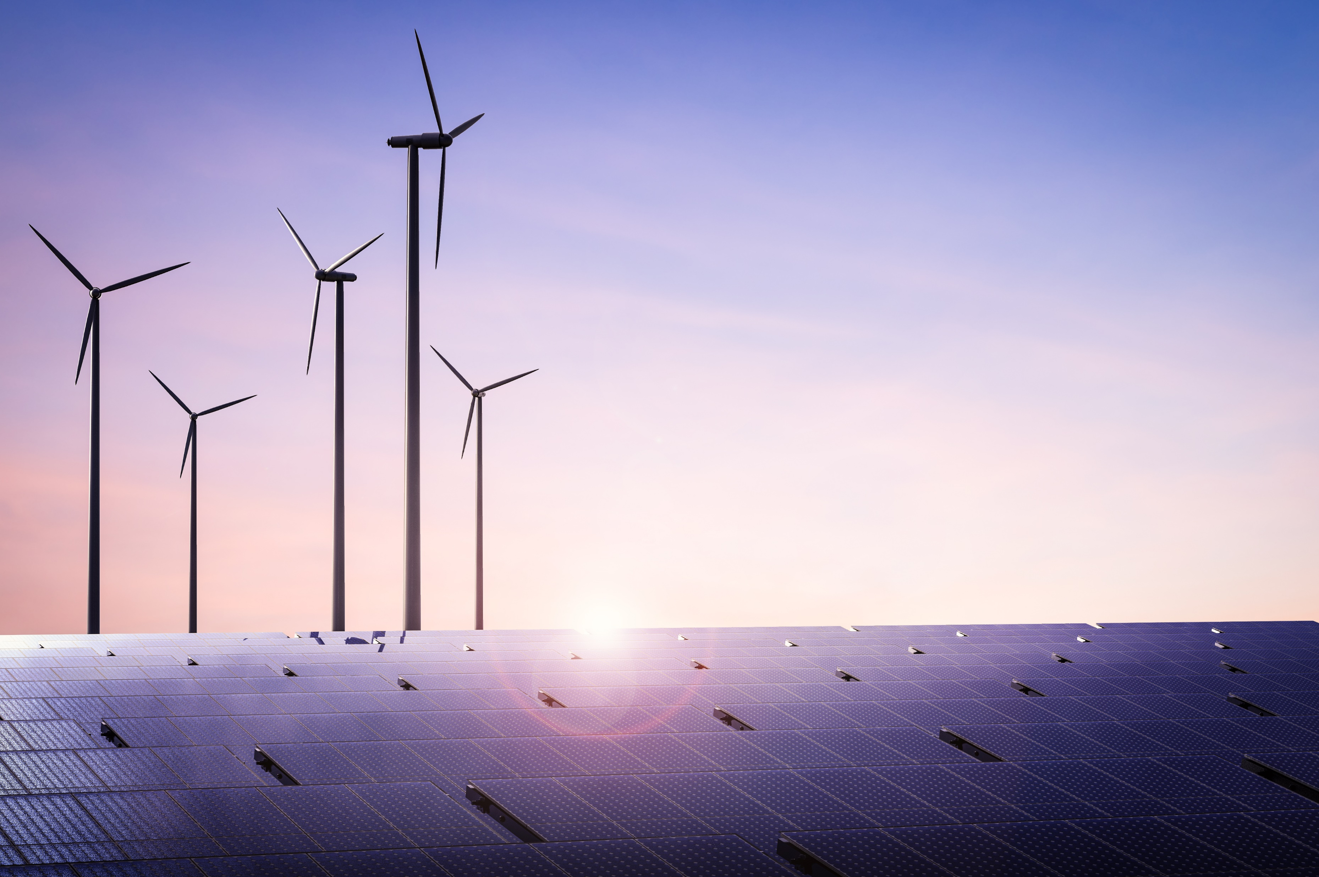
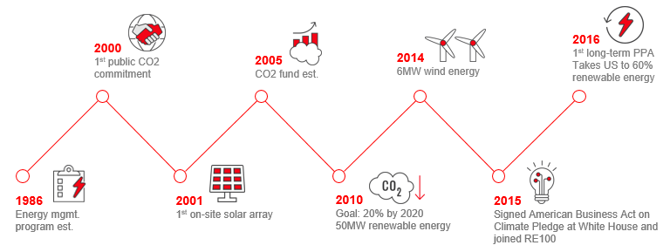
Our Energy & Climate Journey
1986
2000
2001
2005
2010
2014
2015
2016
Energy mgmt. program est.
1st on-site solar array
Goal 20% by 2020 50MW renewable energy
Signed American Business Act on climate Pledge at White House and joined RE100
1st public CO2 commitment
CO2 fund est.
6MW wind energy
1st long-term PPA Takes US to 60% renewable energy
2020 Renewable Energy Goal
Increased to 35% with an aspiration to power all of our facilities with renewable energy by 2050.

Slide 4
Our Reach (or how we think about sustainability)
Our Products & Business Models
Our “Four Walls”
Our Extended Supply Chain
The World
Notes:
Sustainability reach and impact I beyond our four walls – facilities, external manufacturing, suppliers, products and world
1st 3 are what you have to do.
World is leadership
Blend products between the two

Slide 5
Our Environmental Aspirations
As a global healthcare company, our commitment to environmental health is an extension of our mission and vital to our aspiration to profoundly change the trajectory of health for humanity.
We believe healthy people and a healthy business need a healthy planet

Slide 6
Operate On a One Planet Budget

Slide 7
Care for the planet like our health depends on it

Slide 8
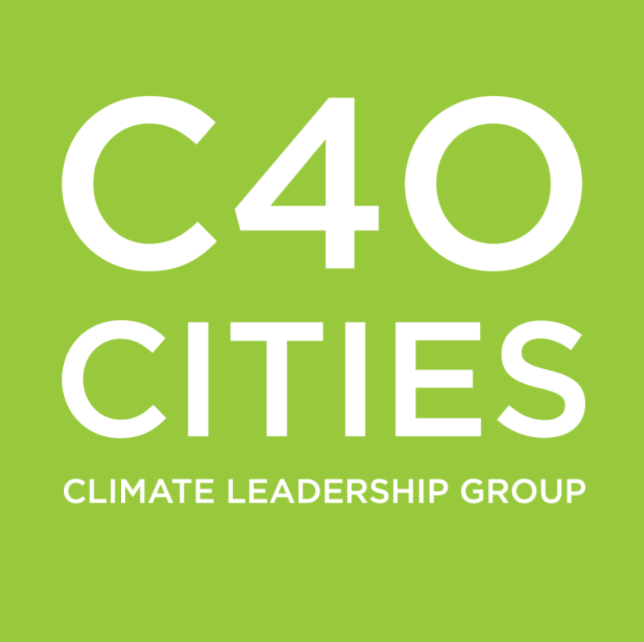
Partnerships at the intersection of environmental/human health expand the scale of our impact
Physicians Educating Patients + Advocating for Sound Environmental Policy = Better Population Health
Mayors Acting on Climate Change = Better Air Quality = Better Urban Citizen Health
8
Notes:
While we have two partners working on a similar problem – the health impacts of climate change and air pollution – the affected audiences are slightly different and the theory of change is different with each of the partners.
C40: The partnership through research and education, will help connect the dots between climate action, improved air quality and measurably better health benefits in vulnerable urban areas.
Our 5-year SDG target: 100 million citizens living across 30 cities will have benefited from climate and air quality actions that have the potential to positively impact public health.
MSCCH: Most Americans are not aware of the health harms of climate change. As physicians are a trusted source of information, support for MSCCH helps give physicians the knowledge that they need to educate their patients on the health impacts that they can expect to see and gives them the tools that they need to become advocates for better public policies that support improved environmental health through action to mitigate climate change and control air pollution, and ultimately improve human health

Slide 9
Widen
your lens

Slide 10
Imagine the possibilities
What if we all cared for the planet like our health depended on it?

