Slide 1
“Climate Changes Things”
Cheryl L. Holder, M.D.
Associate Professor
FIU/Herbert Wertheim College of Medicine
Pres. Florida State Medical Association

Slide 2
Ms. Anna Mae
Ms. Anna Mae is a 64 y.o. African American non-smoking, woman living in Opa locka, Fl with HTN, T2DM, HLD, Mild Intermittent Asthma, Obesity treated with lisinopril 20mg daily, amlodipine 5mg daily, metformin 1000mg twice daily, pravastatin 80mg nightly, aspirin 81 mg daily, albuterol prn. She is adherent to medications and medical visits. She presented for an earlier visit for an albuterol refill and to ask that I complete her Florida Power and Light application form for reduction in her bill.

Slide 3
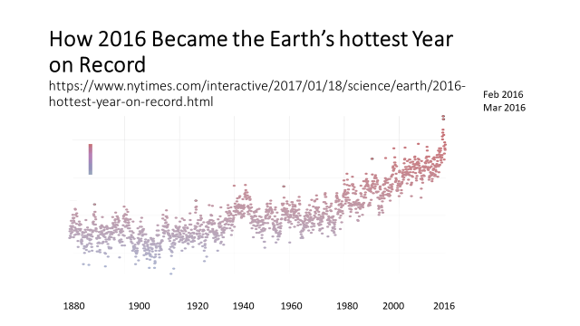

Slide 4
Insured value of property in the coastal counties of Florida is estimated at $2.9 trillion.
Florida Energy and Climate Commission – Dismantled by Gov. Scott 2011
In 2016, Miami Beach Miami Beach has launched a $400 million project mitigate flooding.
In 2017, Governor Scott budgeted $50+ million dollars for beach “renourishment”.
78 billion gallon reservoir south of Lake Okeechobee - $1.5 Billion to help prevent toxic algae bloom.
November 7, 2017, Miami voters approved $400 million dollar general obligation bond called “Miami Forever.
$192 million for infrastructure projects needed to address flood prevention and sea level rise mitigation ($208 mil for affordable housing)

Slide 5
Florida Organizations
Southeast Florida (Miami Dade, Broward, Palm Beach and Monroe) Regional Authority
Climate Science Advisory Panel ( Tampa Bay and Pinellas County)
Florida Climate Institute -http://floridaclimateinstitute.org/
CLEO Institute- http://cleoinstitute.org/
Miami Climate Alliance
Physicians for Social Responsibility - Florida Chapter
Catalyst Miami
Moms Clean Air Force
New Florida Majority
Miami Searise

Slide 6
Climate and Health
$0 bond funds for health
Florida Clinicians for Climate Action
Tampa Declaration: https://champ.ms2ch.org/ptn/1/

