Slide 1
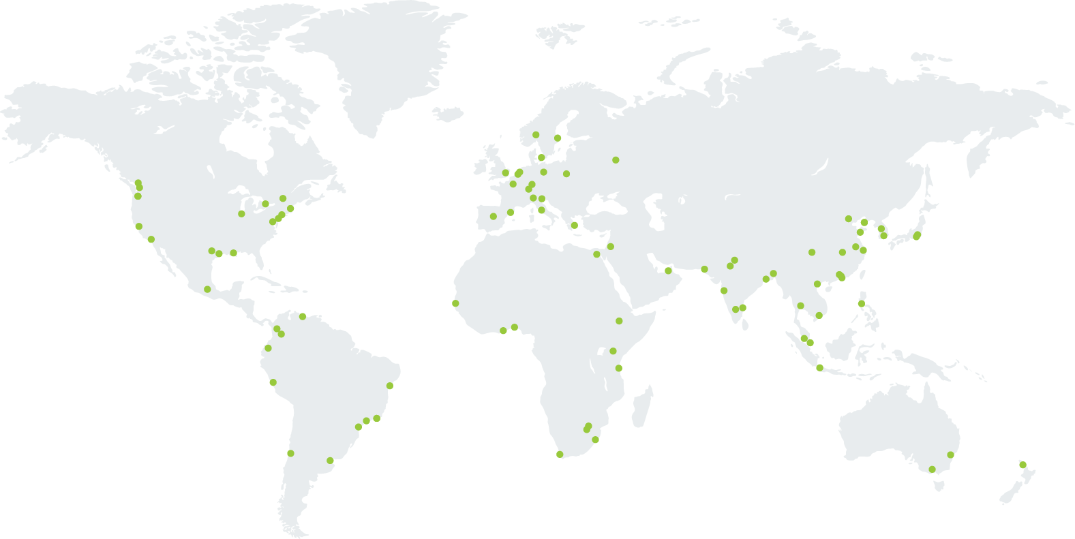
C40 Cities: An International Alliance of Mayors
90+
Cities
650+
Million Citizens
1/4 of the
Global Economy

Slide 2
C40 Business Plan: Moving the Paris Agreement from aspiration to action
Connectivity – Alignment – Collective Impact
Notes:
The central focus of the 2017 – 2020 Business Plan is to enable every C40 mayor to commit to a development strategy for their city that is in line with what is needed to deliver the Paris Agreement.
At COP21 nation states agreed a target to constrain global temperature rise to 1.5 degrees
But the commitments governments made in Paris would only actually deliver somewhere between 2.5 and 3 degrees of temperature rise - As Sir David King, the special adviser on climate change to the British government said in Marrakech recently, the difference between 1.5 degrees of warming and 2 degrees is between manageable and disastrous
So there needs to be major emphasis on action from non-state actors
C40’s business plan proposes that C40 Cities should lead that effort and Deadline 2020 is the routemap to get there
- But is a 1.5 degree target still achievable?
- What is the route map to get there?
- What do individual C40 cities need to do to contribute?
And how can C40 best support those efforts?
Deadline 2020 sets out to begin to answer these questions

Slide 3
CLIMATE AND AIR QUALITY
Delivering healthy, liveable cities through Climate Action
“Responding to climate change could be the greatest global health opportunity of the 21st century”
The UCL-Lancet commission on health and the environment
Notes:
SPEAKER NOTES:
Intro/background to benefits research = we have to act now, making the case for climate action is one of the biggest barriers that cities face (ref C40 potential and unlocking reports), so C40 launched the benefits research programme…
As well as a huge challenge it is also a huge opportunity…
Cities are facing the impact of climate and air q now so have to act on both, climate and air q share a lot of the same root causes and there is also the potential for them to share solutions and opportunities – in particular HEALTH

Slide 4
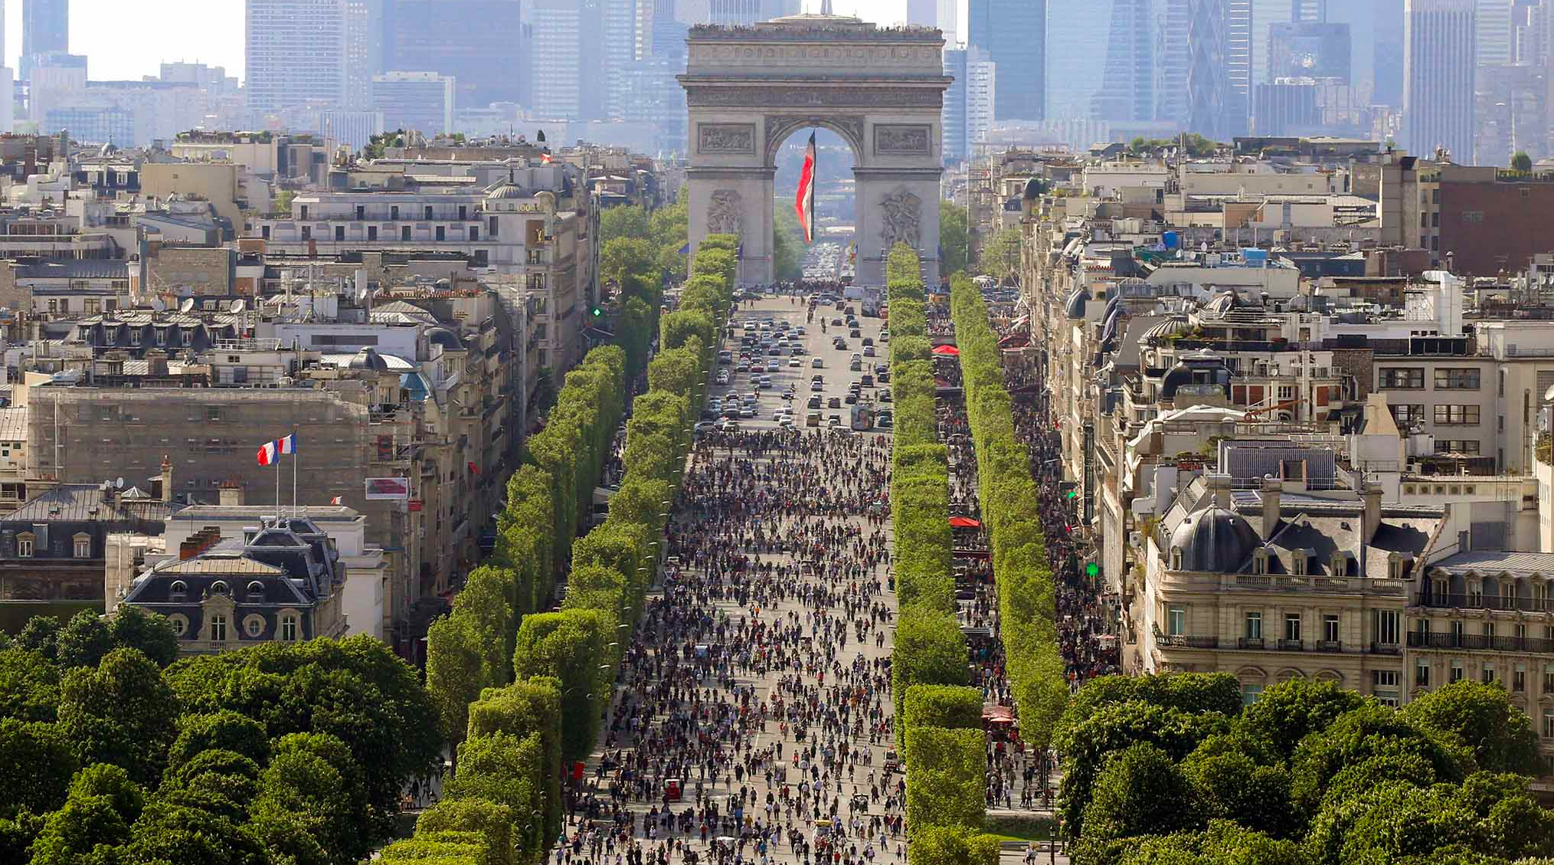
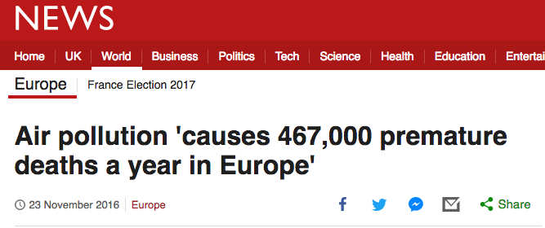
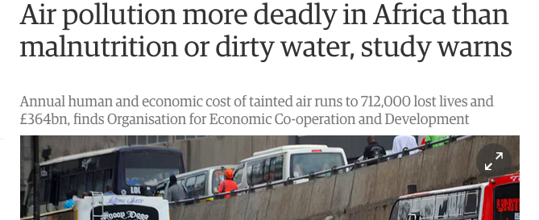
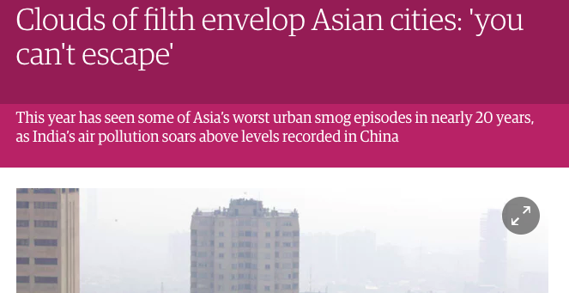
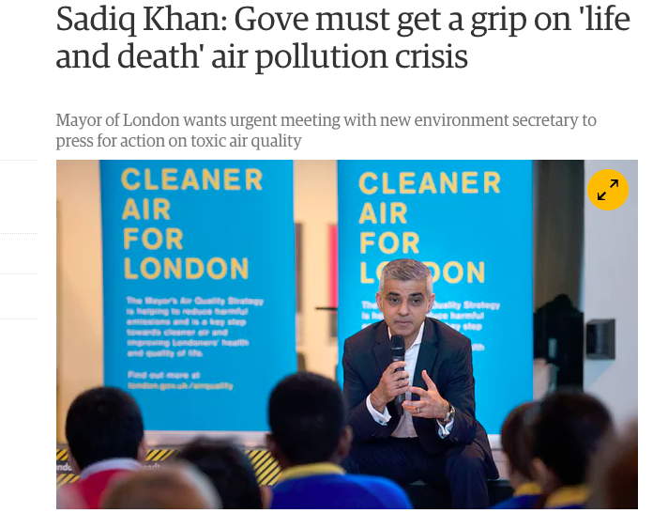
CLIMATE AND AIR QUALITY
Air pollution a rising political challenge and priority for C40 mayors
Notes:
It’s clear that air quality has captured the public’s attention. When you look at these headlines, it’s easy to see why. And because of the severity of the problem and the unfortunate ease it is to write headlines like this, it forces mayors to be ready with answers.

Slide 5
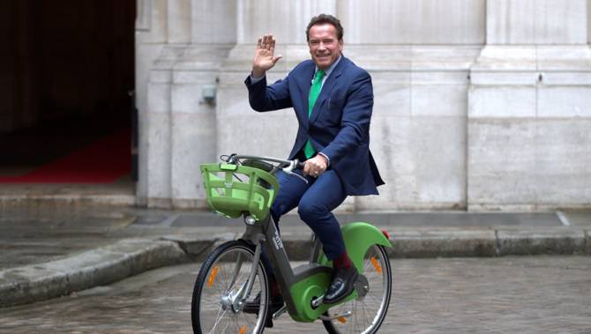
A Global Approach to Benefits Measurement
CLIMATE AND AIR QUALITY
Enabling cities to effectively and efficiently measure the wider benefits of climate action
Practical, viable method
City data + research
Compelling evidence
Stronger case for action
Notes:
SPEAKING NOTES – don’t need to cover all of this!!!
Global approach – cities asked us for a standard, common methodology so that results are comparable and they can benchmark against each other
Practical, viable method – need a methodology that works with the resources available, i.e. the staff time and skills/capacity, the available data, and available money – cities can’t afford to do a full blown CBA, EIA, HIA for every option they consider, our approach is designed to be practically viable for cities to use to get a ROBUST first order estimate/measure
City data + research – we achieve this viable yet robust methodology by combining city data + existing research, e.g. we support cities to measure the change in emissions from a transport action and then translate that into health benefits using a multiplier, in this case a Concentration-Response Function, from existing research (Brendan as a medical audience I think they’ll all know what a CRF is, I assume you are happy to just sign post any detailed questions on this sort of thing to me via e-mail) – our value add is in making research available to cities, without support cities simply aren’t able to access the latest research in this way
Compelling – we work directly with the experts to make sure we are using the most robust evidence, in this way C40 provides assurance for the quality/robustness of data ensuring cities can be confident in evidence (for AQ we are working with Prof Paul Wilkinson from London School Hygiene and Tropical Medicine, he advises the UK gov on air qual)
Stronger case for action – the aim of the whole thing is to use results to make a stronger case for action based not jus ton climate but on wider economic and social benefits – of which health is a major one.
CALL OUT HERE – or at some point – TO ACADEMIC COMMUNITY TO HELP US IDENTIFY THE BEST EXISTING RESEARCH THAT WE CAN USE TO SUPPORT CITIES TO MEASURE BENEFITS.
Pictures are from a press release with Arnie and Mayor Hidalgo talking about climate action, FFFS and the health benefits from both air quality and physical activity = great example of the power of results in promoting climate action – can talk about e.g. 400 premature deaths avoided from Paris going FFFS and 23% reduced in risk of heart attack and stroke when you ditch the car and have an active commute.
Dec 11th press release – summary results
Under the commitments made by Paris in the Green & Healthy Streets Declaration, the city of Paris will be closed to fossil fuel vehicles by 2030 and will only procure electric buses by 2025. C40’s calculations suggest this has the potential to reduce PM2.5 levels in the city of Paris by approximately 1.3 micrograms per metre cubed.
This will avoid an estimated 400 air quality related deaths per year and add 21 days to life expectancy on average for every resident in the city of Paris
This will prevent an estimated 1,280 respiratory hospital admissions and 6,350 cardiovascular hospital admissions annually triggered by air pollution
This analysis only looked at the residential population of the city of Paris, there are an additional 1 million people living outside the city of Paris but working in the city of Paris who will also benefit from air quality improvements.
This only accounts for tailpipe emissions. The air pollution created by the wear on breaks tyres can only be tackled by reducing the number of vehicles
Improving air quality, in particular reducing the amount of very small particulate matter (PM2.5) reduces the risk of mortality. If all C40 cities reduced PM2.5 by 2.5 micrograms per metre cubed - by for example meeting the commitments of the Green & Healthy Streets Declaration and encouraging more people out of their cars - it would potentially prevent more than 45,000 premature deaths each year.
For a city like Paris, and many other across Europe and North America, reducing PM2.5 levels by 2.5 µg/m³, is a tough but realistic goal. This represents a significant portion of non-background PM2.5 pollution and an ambitious but achievable first step on the road to tackling poor air quality.
For many cities in India and China, efforts to tackle air pollution will bring PM2.5 levels down much further, thereby preventing many more premature deaths, so this 45,000 figure is certainly a low estimate of what can be achieved through decisive climate action.
(Switching from driving to) an active commute to leads to:
23% reduced risk of heart disease,
23% reduced risk of stroke,
14.5% reduced risk of type 2 diabetes,
14% reduced risk of depression,
12.25% reduced risk of breast cancer
11% reduced risk of dementia, and
7.8% reduced risk of colon cancer
This is based on a 15 minute active commute to and from work, 30 minutes in total per day, 5 days a week, 150 minutes per week.
Walking at a brisk pace or cycling achieve these health benefits
An active commute also saves carbon, we estimated that if 10% people in North American C40 Cities switch from driving to cycling that would save 1.6 million tonnes CO2 each year.

Slide 6
Making the case
Deploying clean transportation programs across all C40 cities could prevent 45,000 premature deaths
Cycling in EU saves 15 million tonnes CO2 and €3 billion
By 2030, renewables could save up to $230 billion and prevent 500,000 premature deaths annually
By 2050, climate strategies could increase average life expectancy in China by 20 months by 2050
Notes:
GLOBAL
Implementing climate mitigation strategies could increase average life expectancy in China by 20 months by 2050 – Lancet commission on health and climate change 2015. In China, air pollution is thought to result in 7.4 times more premature deaths from PM2.5 than in the EU. It has been estimated that current ambient concentrations of particulate matter led to the loss of about 40 months from the average life expectancy in China, but that this loss could be cut by half by 2050 if climate mitigation strategies were implemented.
Renewables can save up to$230Bn and avoid 500,000 premature deaths annually by 2030, 2.2M by 2050 - Lancet commission on health and climate change 2015. With an increase to 36% renewables in global final energy consumption by 2030 (from 18% in 2010), IRENA calculates up to $230 billion of avoided external health costs annually by 2030. In addition, West and colleagues note that if RCP4.5 is achieved, annual global premature deaths avoided reach 500 000 by 2030, 1.3 million by 2050, and 2.2 million by 2100.
(health) benefits of CO2 mitigation policies can off set the cost of the policies by up to ten times. Lancet commission on health and climate change 2015. In the USA, Thompson and colleagues estimate that human health benefits associated with air quality improvements driven by CO2 mitigation policies can off set the cost of the policies by up to ten times
low-carbon urban actions available today could generate a stream of savings in the period to 2050 with a current value of US$16.6 trillion, and could reduce annual GHG emissions by 3.7 Gt CO2e in 2030. (NCE 2015)
Job creation - around 1.9 million ee related jobs in America alone - ~1.9M energy efﬁciency jobs in America - Nearly 1.9 million Americans work in energy efficiency related jobs. Of these, roughly half—or 889,000—spend the majority of their time working on energy efficiency projects.
Infrastructure savings – cycling in EU saves 15,248,644 CO2t, AND avoids 3,009,097,192 Euro on infrastructure costs (also prevents 27860 deaths per year).

Slide 7
Pilot
CLIMATE AND AIR QUALITY
A Global Approach to Benefits Measurement
Novo Nordisk – Walking & Cycling
Houston
Milan
Santiago
San Francisco
Nairobi
Buenos Aires
Vancouver
Bangalore
Rio
Barcelona
Bogota
Cape Town
J&J – Air Quality
Paris - FFS
Santiago - cookstoves
Salvador – Cleaner buses
Joburg – electrification
Barcelona – LEZ
Athens – LEZ
Istanbul – floating PV
Hanoi – BRT (moped ban)
Quezon City – emissions regs
Karachi – BRT
Buenos Aires – BRT
Quito – emissions regs
Medellin – bus upgrade
Mexico City –industrial ee
Bike share launched
Safer crossing
National funding
30–40 million citizens improved health
LEZ exchange
Greater enforcement
NYC – Retrofit
Mexico City – Cycling & Walking
Santiago – BRT
Joburg – Solar thermal Retrofit
Melbourne – Urban Forestry
Notes:
SPEAKER NOTES – again probably too much here so just dit out what you don’t want
What have we done so far?
Pilot in 2016 to develop and test a global approach – 1st image of the 5 pilot cities and actions
In 2017 we rolled out the approach to more cities focusing on walking and cycling and Air quality – Boxes with the list of cities wwe worked with
What has been the impact?
Through supporting these cities to demonstrate the wider benefits from climate change we have helped to drive more action – just giving a few examples because of time:
Bike share launched – Bangalore came to our walking and cycling masterclass and as a result launched abike share scheme
Safer crossing – Rio also attended our walking and cycling masterclass and used the tools and techniques from this to review a key street connecting two transport hubs to make pedestrian crossings safer
National funding – Cape Town are using the methodology to show the benefits of cycling in order to secure national funding for further investment in their cycle network
30–40 million citizens improved health – estimated potential health impact from the climate and air quality actions that we helped the 14 cities supported last year to measure benefits of.
LEZ exchange – we supported Barcelona to look at the air quality and health impact of their Low Emission Zone, not only has this helped them decide what level of restrictions to set but it has created a case study that several other of our cities are very interested in using to make the case for their own LEZs
Greater enforcement – Quezon City reviewed the impact from a regulation to ban the most polluting vehicles and through the process identified that enforcement was critical, they used the results to make the case for an additional enforcement team

Slide 8
“… big cities around the world can pool their expertise and their influence to encourage big industry to clean up its act.”
– Mayor Kahn of London
London, Madrid, Mexico City, Milan, Moscow, Oslo, Paris, Seoul and Tokyo
London Clean Vehicle Checker (2017)
Independent testing: TRUE project with ICCT, Paris, London (on-road emissions testing and car rating, 2018)
Notes:
March 2017 the Mayors of London and Paris announced their plans to launch real world vehicle emissions data online to help citizens in their cities to choose the least polluting cars. 7 other global mayors joined London and Paris in their support for the development of a global car scoring scheme (Seoul, Tokyo, Milan, Mexico City, Moscow, Madrid, Oslo)
London launched their Clean Vehicle checker in October 2017, enabling citizens to search for the cleanest cars
Paris and London are working with ICCT and other institutions on the TRUE project - measuring Real Urban Emissions on the road in both cities, and developing the TRUE car rating due to be launched in Europe this spring.

Slide 9
CLIMATE AND AIR QUALITY
Los Angeles pilot to assess city power to act
1,600 premature deaths per year
Children have 10-15% lower lung function
74% greater risk of asthma
37% greater risk of cancer
33% greater risk of bronchitis
Assess existing program & policy impact on health (e.g., incidence of asthma)
Target new policy & program decisions to improving health / quality of life
Climate actions linked to health outcomes: detailed street level AQ monitoring, targeted use of Clean Vehicles
Notes:
It’s clear that air quality has captured the public’s attention. When you look at these headlines, it’s easy to see why. And because of the severity of the problem and the unfortunate ease it is to write headlines like this, it forces mayors to be ready with answers.

