Slide 1
Flooding & Health Services Delivery, Personal Reflections
Claude Tellis, MD, pulmonologist
Baton Rouge, Louisiana
National Medical Association

Slide 2
After The Flood
Status of Families and Children
April 2018
Claude J. Tellis

Slide 3
After the Flood: Effects on Children 2018
No disclaimers

Slide 4
Baton Rouge by the Mississippi

Slide 5
The Rain
Average annual Rainfall
Baton Rouge 60.7 inches
Lafayette 60.5 inches
Hammond 62.6 inches

Slide 6
The Rain 2016
On Thursday, August, 11, 2016, the rain began.

Slide 7
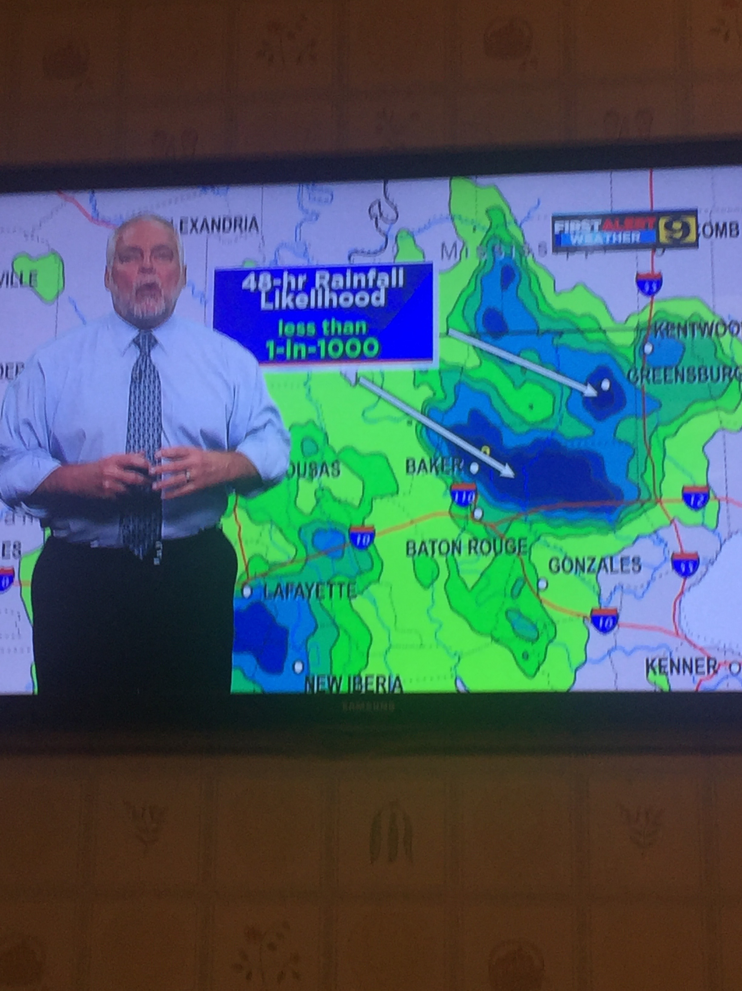

Slide 8
Unprecedented Record Rain, Aug 2016
Initially:
Most catastrophic rain since Superstorm Sandy
20” fell within hours
Governor declared state of emergency
Coast Guard rescued 20,000 (weather.com)
Ten thousand in shelters (weather.com)
36,000 filed for disaster aid
Governor request $4 billion flood aid

Slide 9
After the Flood 2018
Massive rain in August 2016
Sheets of rain for hours: 2 inches per hour
1,000 year flood
Up to 31 inches of rain fell in some areas; 7.1 trillion gallons (Hurricane Katrina left 2.1 trillion gallons); enough to fill Lake Ponchartrain 4 times over. Average of over 20 inches of rain in 48 plus hours.
Hurricane Harvey: 51.88 inches of rain: 33 trillion gallons of water

Slide 10
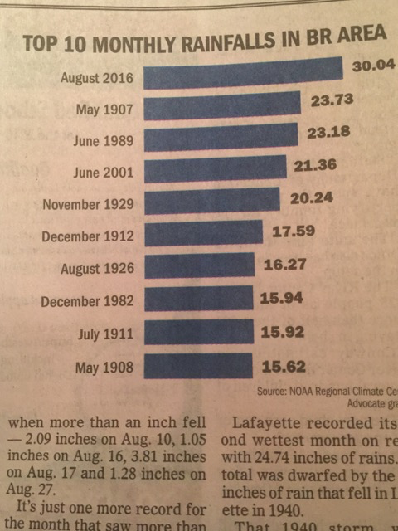

Slide 11
Here's how much rain fell in Louisiana - USA Today
https://www.usatoday.com/story/news/2016/08/15/louisiana-flooding.../88759214/
Cached
Aug 15, 2016 - In a normal August, Baton Rouge usually gets 2.5 inches of rain from Aug. 1 to Aug. 15, according to weather service data. This year, 21 inches -- more than 8 times as much -- soaked the city since Aug. 1.

Slide 12
This was Life Threatening

Slide 13
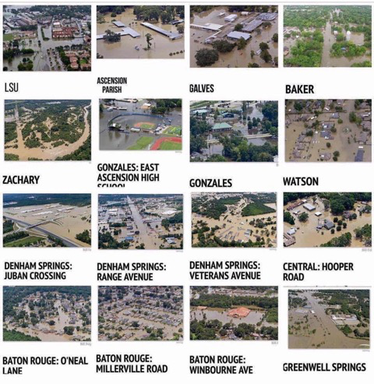

Slide 14
Flooded Parishes in Louisiana August 2016
This was not a localized event

Slide 15
Rescues

Slide 16
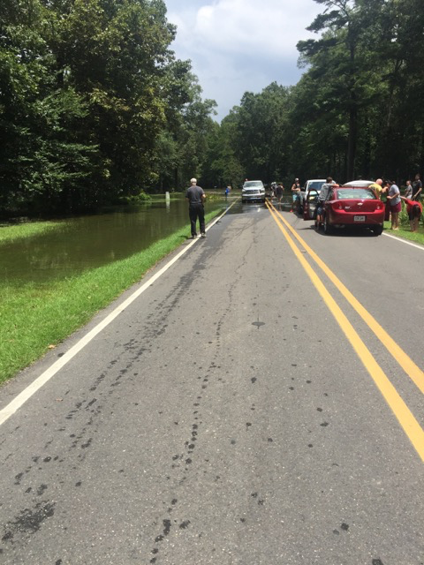

Slide 17
Thousands of Families Took Shelter; Their Homes Damaged

Slide 19
After the Flood: Effect on Children 2018
No clothes
No medicines
No transportation
No shelter

Slide 20
After the Flood: Its Effect on Children 2018
Health issues over the next days and weeks of
August and September, 2016:
No medicine for hypertension, diabetes, heart problems, asthma or chronic obstructive lung disease
Stress
Anxiety
Depression
West Nile Virus

Slide 21
New Routes to Medication

Slide 22
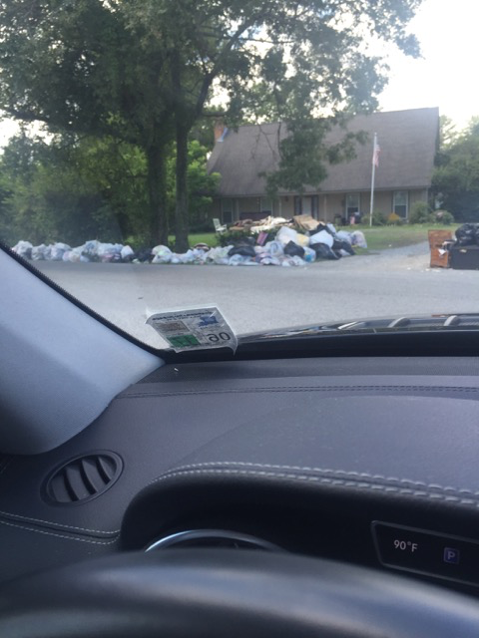

Slide 23
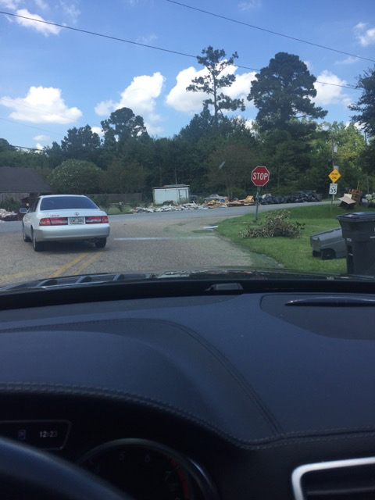

Slide 25
After the Flood 2017
A year later…

Slide 26
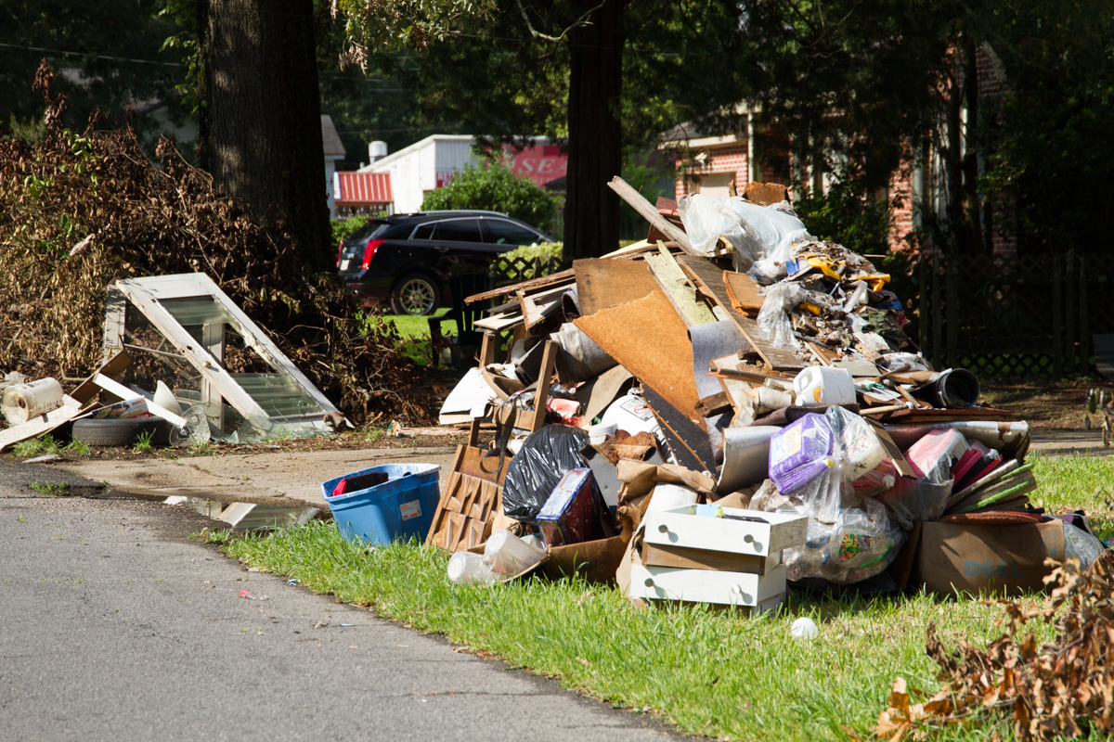
Notes:
One year after the stprm

Slide 27
After the Flood 2018
Looking back: News reports and personal interviews:
Medicines were lost.
The magnitude of the problem is unclear but practitioners and pharmacies report replacing many prescriptions
A few asthma cases from mold were seen(report from a pediatrician)
Private practitioners noted a decrease in visits.
Schools were closed for a few weeks
School counselors reported children fear any rain.
The major problem reported was and is stress, anxiety and depression.

Slide 28
After the Flood 2018
In 2017, The Advocate in a article on stretched funding and memories of the 2016 leading to a perfect storm for mental health crisis, reports that
There was a rise in adolescent psychiatric admissions-341 to 548- in a year.
Clients of a local psychologist are concerned that their children are now more fearful of thunderstorms.

Slide 29
After the Flood: Effect on Children 2018
One year after the flood, John Upton in an article on how the most vulnerable are coping, reports in The Grist, an Environmental online magazine:
One in four families are in poverty
The Government provides 13 cents for every dollar lost(65-70 cents recent past)
There are sleeping and eating disorders. Domestic violence and drinking have increased

Slide 30
“You see people who still don’t have homes, and it’s so sad, it’s heartbreaking,” said Katherine Washington, a 59-year-old teacher living with a daughter and foster daughters in a FEMA trailer in their north Baton Rouge yard while their house is repaired. Their furniture, clothes, photos, and toys were destroyed by the flood. Later, thieves took Washington’s washer and dryer from her wrecked laundry room and the tires off her flood-damaged car. Their street is still pocked by empty houses.

Slide 31
After the Flood 2018
Issues remain in 2018:
Displacement: temporary shelter, trailers, motels, living with family( friend's son and family)
Emotional issues: fear, anxiety, depression, PTSD
Nutrition issues
Fear of persistent rain and of return flooding
Many are still repairing homes

Slide 32
After Effects
Mental Health
Home Repairs

Slide 33
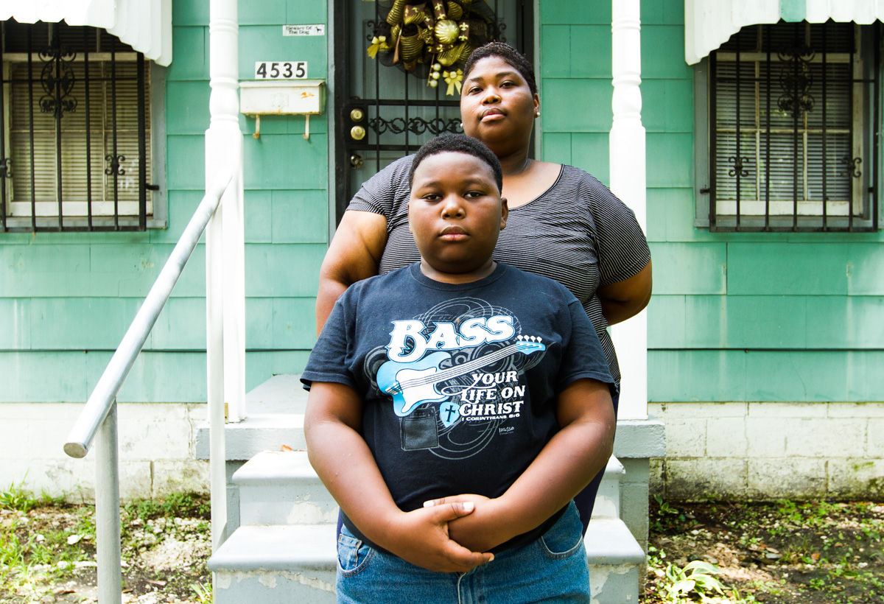

Slide 34
After losing almost everything to Hurricane Katrina, Shantel Smith and her family have lost almost everything again. For several days after the storm eased, they stayed with a relative while waters receded. They saw one of their houses in a photo on Facebook, only its roof peeking above the water.

Slide 35
Depressive disorders and post-traumatic stress disorder, which are afflicting Louisianans in the wake of the Great Flood, can be common after a disaster. Women are more likely to develop depression and anxiety and men are more likely to turn to drugs and alcohol, said Carol North, a psychiatry professor at the University of Texas Southwestern Medical Center.

