Slide 1
Clinical climate change teaching at Georgetown University School of Medicine
Caroline Wellbery MD
Professor
Family Medicine

Slide 2
Climate change in medical education: What to do?
Objectives
1.5 hour workshop
Third year FM clerkship module
Electives
Fellowship

Slide 3
Patients. Populations, Policy course Intro to climate change
Define environmental health/climate change
Knowledge about climate change: mechanisms, causes, manifestations
Health effects of climate change
Beliefs about the reality and importance of climate change
Climate change in medical education
Future directions

Slide 4
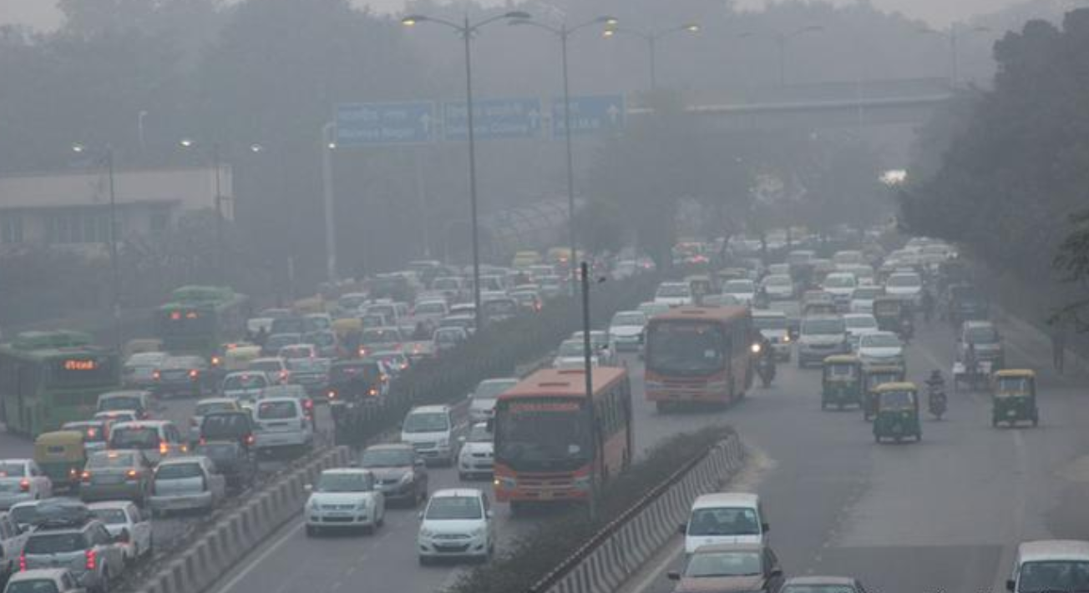
Third year Clerkship Module : Air pollution & climate change

Slide 5
Objectives
Describe the interactions between the effects of climate change on air pollution and how this interaction might potentiate respiratory diseases.
Relate impact of air pollution to previous discussions about racial disparities.
Evaluate behavioral recommendations to patients with respiratory symptoms (use of sensors, face masks and reduction of outdoor activities)
Determine the extent to which climate health should be incorporated into clinical conversations.

Slide 6
Health effects of air pollution

Slide 7
Notes:
Poor air quality becomes even worse as temperatures continue to rise. Greater warmth and sunlight interact with exhaust to produce more ground-level ozone, a common pollutant and powerful lung irritant. Warming temperatures can aggravate the effects of air pollution. Increased levels of particulates exacerbate preexisting respiratory conditions and lead to higher rates of hospitalization and death.

Slide 8
Cardiovascular effects

Slide 9
Breakout Questions
1. What effects of climate change have an impact on air quality and by what mechanisms do increased temperatures affect air quality?
2. List common air pollutants and by what mechanism do they harm health?
3. What are the health effects/outcomes of air pollution?
4. Which populations are the most vulnerable and what environmental conditions increase individual vulnerability? How might lower SES influence exposure or susceptibility to air pollution?
5. What is the air quality in dc today and what does it mean? What advice would you give your 16-year-old asthma patient if the air quality index is 130? What are your options in counseling your vulnerable patients? How useful are face masks?

Slide 10
Using the Air quality index (AQI). Calculate today’s air quality based on the zip code of the place you grew up in. If you grew up in another country, google air quality of the nearest city you grew up in. How does the air quality compare to that of New Dehli?

Slide 11
Can and should you talk to your patients about the respiratory effects of air pollution? Climate change?

Slide 12
Where should students go from here?Summary messages
The only solution is to use less energy/burn fewer fossil fuels
Education: Competencies, requirements
Patient care
Local activism
Large-scale activism

Slide 13
Patient care example Personal behaviors:Teach co-benefits

Slide 14
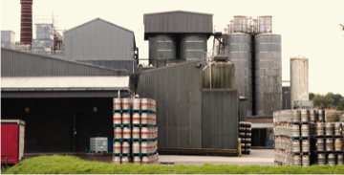
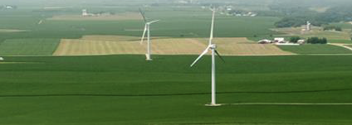
Gundersen Health, USA
Local Activism Example:
Low Carbon Health Care:
Investing in Community Resilience
Courtesy Gary Cohen Healthcare without Harm https://www.noha
rm.org/
83% emissions cut since 2008.
Energy independence in 2014
60% Clean Renewable
40% Energy reduction
Saves US $2-million per year
Renewable energy
Solar power
Geothermal energy
Wind Turbines
Dairy digesters
Combined heat and power
Biomass boiler
Photo: Gundersen Health
Notes:
The Wisconsin-based health system is the first in the U.S. to achieve complete energy independence: as of October, 2014, it produces more energy than it consumes. Gunderson reached its goal by improving energy efficiency by more than 40 percent (for a savings of almost $2 million), and investing in renewable energy sources, including solar power, geothermal energy, wind turbines, dairy digesters, combined heat and power (CHP), and a biomass boiler.

Slide 15
Advocacy/Activism

