Slide 1
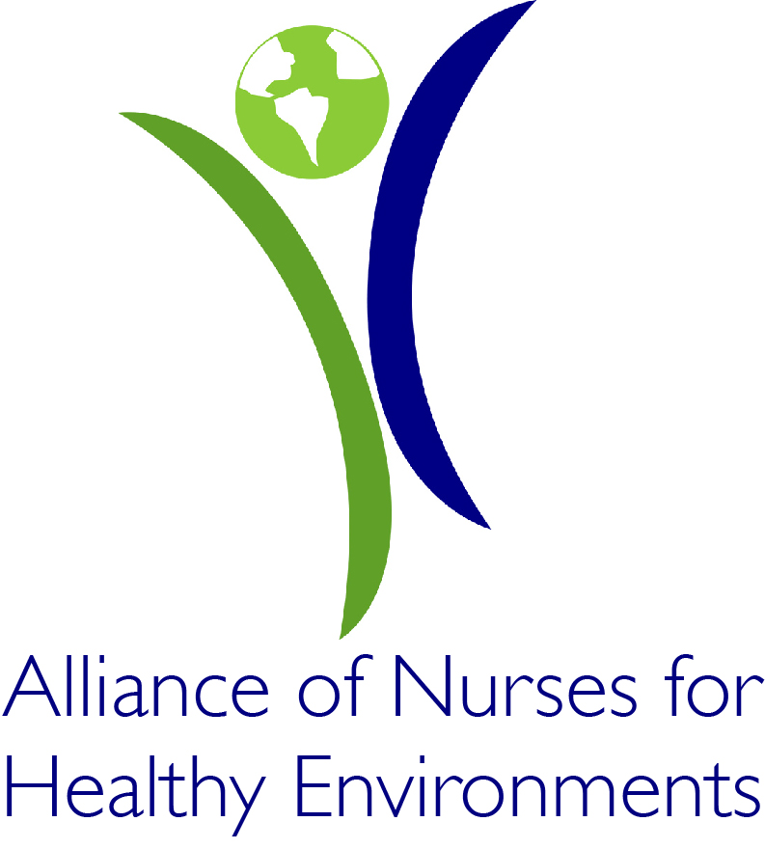
Medical Society Consortium on Climate and Health
Lois Wessel, RN, CFNP
Alliance of Nurses for Healthy Environments
Georgetown School of Nursing and Health Studies
April 9, 2010

Slide 2
Alliance of Nurses for Healthy Environments (AHNE)
Promoting healthy people and healthy environments by educating and leading the nursing profession, advancing research, incorporating evidence-based practice, and influencing policy.
Notes:
Who you are, what is your organization and your motivation for engagement

Slide 3
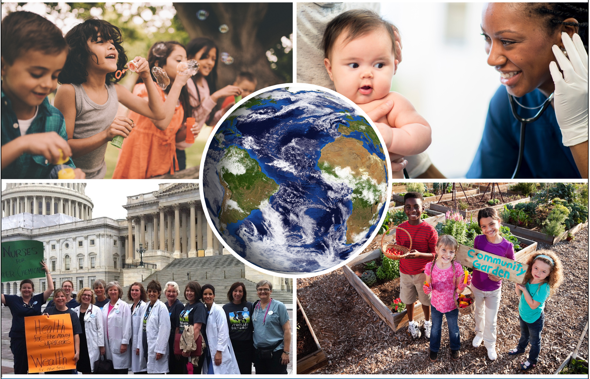
Alliance of Nurses for Healthy Environments (AHNE)
Education Work Group
Research Work Group
Practice Work Group
Policy Work Group
Climate Change
Safer Chemical
Food Sustainability
Energy and Health
Notes:
3. Curriculum outline and story of development
4. Sources of content for educational materials
In December 2008, fifty nursing leaders were selected to represent the nursing profession at a 4-day, invitational meeting to develop a strategic plan for environmental health nursing. They represented the following: nursing sub-specialty organizations ranging from nurse midwives, school nurses, and nurse practitioners, to critical care, neonatal, and public health nurses: state nursing associations; as well as the national organizations of Black and Hispanic Nurses Associations. While there were many small accomplishments at this meeting, the two that stand out are the following:
A national organization was born – the Alliance of Nurses for Healthy Environments
An organizational structure was constructed and 4 main Work Groups were created to begin the important work of this new Alliance: Education, Practice, Research, and Policy/Advocacy.
In June of 2009, ANHE developed a guiding document that drives the work of the work groups. Read: the ANHE Wingspread Statement
The Alliance is growing as nurses from around the country, and the world, join the Work Groups to participate in meaningful national efforts. Each of the Work Groups holds monthly or bi-monthly calls. All nurses are encouraged to join these calls. Together these Work Groups are coordinating their efforts and reaching out to nurses around the country. The Alliance of Nurses for Healthy Environments welcomes any and all nurses who are interested in the environment to join the Work Group that best reflects their interests.

Slide 4
Target Audience
Nurses are the #1 most trusted profession
Focus on human health & environment
Evidenced base information
Education nursing profession
Advancing research
Influencing policy
Incorporating environmental knowledge into practice
Notes:
We are in a new dawn regarding environmental health in the US and, in fact, globally. The public awareness and interest in all things “green” is creating a demand for nurses to understand the relationship between human health and the environments in which we live, learn, work, and play. We have moved beyond questioning the science of whether we are in environmental health peril to almost unanimous consensus that we must act and act now on many of the risks we are all experiencing.
Nurses, who are one of the most trusted sources of information by the public, must be in a position to both respond to questions about the environment and its relationship to health with credible, evidence-based information, as well as provide leadership in making the necessary changes in our policies and practices. To that end we must prepare nurses to be a cut above the average citizen with regard to their knowledge of environmental health issues.
The Mission of ANHE: Promoting healthy people and healthy environments by educating and leading the nursing profession, advancing research, incorporating evidence-based practice, and influencing policy.

Slide 5
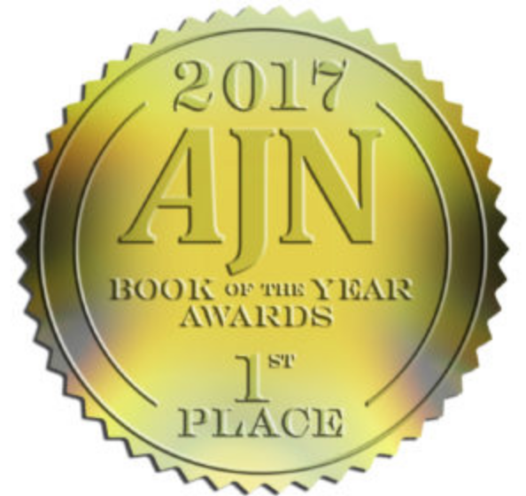
E-Text Book
Why Nursing
Harmful Environmental Exposures and Vulnerable Populations
Environmental Health Sciences
Practice Settings
Sustainable Communities
Climate Change
Energy
Advocacy
Research
Notes:
he e-textbook is divided into eight units, plus an introduction and conclusion: Why Nursing; Harmful Environmental Exposures and Vulnerable Populations; Environmental Health Sciences; Practice Settings; Sustainable Communities; Climate Change; Energy; Advocacy; and Research.
Besides providing a detailed overview of the topic at hand, each unit is rich with live links to resources such as interviews, webinars, videos, and informative websites. Full references are included.
Among other things, readers will find the Top 10 Reasons That Nurses and Environmental Health Go Together, learn about hazardous exposures in health care settings, explore environmental justice, learn how to hold a successful legislative meeting, and get to know researchers and their work via detailed Q&As.
Another important feature of the guide is its electronic format. Besides a search function that lets readers instantly find information on a topic of interest, it contains direct links to authoritative resources such as the U.S. Environmental Protection Agency, the U.S. National Library of Medicine’s Toxicology Data Network (ToxNet) and the World Health Organization.
The textbook’s editors are Jeanne Leffers, Professor Emeritus, University of Massachusetts Dartmouth; Claudia M. Smith, retired Assistant Professor, University of Maryland Baltimore School of Nursing; Ruth McDermott-Levy, Associate Professor and Director of Villanova University’s College of Nursing’s Center for Global and Public Health; Barbara Sattler, Professor, University of San Francisco; and Katie Huffling, ANHE Director of Programs.

Slide 6
ANHR & Climate Change Resources
Continuing Education
Mental and Reproductive Health Impacts
Curriculum guidelines for nursing programs with info across the life span
Advocacy
Ethics
Exposures
Global Health
Activism
Policy
Notes:
In fall 2010, the ANA Scope and Standards of Nursing Practice, 2nd Edition added Standard 16 Environmental Health. This standard requires that practicing nurses meet the competencies of the standard in their professional practice. In addition, the 2008 AACN Essentials of Baccalaureate Education for Professional Nursing Practice includes environmental health for nursing curriculum.
While these recommendations are not new to many nurses who already include environmental health in their academic teaching, for the majority of prelicensure nursing programs, this mandate is new and challenges nursing faculty to respond. The results of a survey conducted by the Education Work Group of Alliance of Nurses for Healthy Environments (AHNE) in 2009 indicate that most often environmental health content is taught in a community/public health nursing course or in a separate environmental health nursing course. In addition, respondents to the survey noted that the majority of faculty in baccalaureate programs felt unprepared to teach environmental health nursing.
AHNE recommends that content that addresses environmental risks to health, issues specific to various life stages such as the fetus, infant, children, adolescents, adults, and older adults, must be integrated across the curriculum. This is necessary in order to prepare nurses to protect humans, create healthy environments, and advocate the reduction of harmful effects of toxins.
n the spring of 2012, a subgroup of AHNE members from the AHNE Education Workgroup met to develop curriculum recommendations for the graduate level of education. Unlike the entry into practice level of education, graduate courses vary tremendously in how courses are organized to address competencies set forth by leading nursing organizations and accreditation programs. Working with this perspective the team used competencies from guiding documents from the Alliance of Nurse for Healthy Environments (2009), the ANA Scope and Standards of Nursing Practice, 2nd Edition (2010), the Essentials of Masters Education in Nursing (2011), The National Organization of Nurse Practitioners document Nurse Practitioner Core Competencies (2012) and the Essentials of Doctoral Education for Advanced Nursing Practice (2006.)
In recognition of the fact that competencies for advanced nursing practice demand higher levels of knowledge and skills, to date most practicing nurses lack the essential knowledge to meet the Standard 16 of the ANA Scope and Standards of Nursing Practice, 2nd Edition (2010) requirements for the basic level of education. Consequently, the Graduate Recommendations include content areas that address both basic and advanced levels of nursing practice.
The recommendations were organized around broad competency requirements put forth in the guiding documents rather than around courses as was done for the entry into practice educational recommendations. The following material for each topical area includes: Appropriate Environmental Health Content, Teaching Strategies and Resources, and Related Environmental Health Competencies from ANA, AACN, and ANHE.

Slide 7
Additional Resources
Journal club
Integration of Environmental Health Into curricula
Study opportunities for nursing students
Continuing Education programs
Take Action
Fact Sheets
Sample Op-Eds
Notes:
Sources of content for educational materials

Slide 8
ENVIRN.ORG

